Slide 1
Web Development Summary
S.No | Name of Project | Industry Domain | Status
1 | SEBO | Retail / eCommerce | Closed
2 | Fitted Running | Retail / eCommerce | Closed
3 | CII | BFSI | Active
4 | Kount | BFSI | Active
5 | Air Products | Manufacturing | Active
6 | AEYC | Education | Active
7
8
In Time Tec – Company Confidential

Slide 2






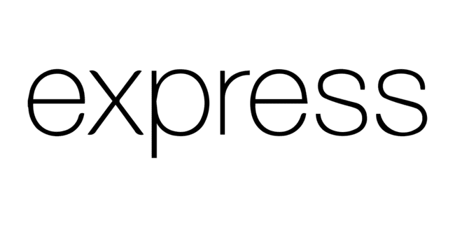







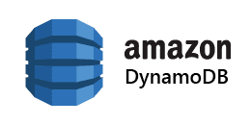


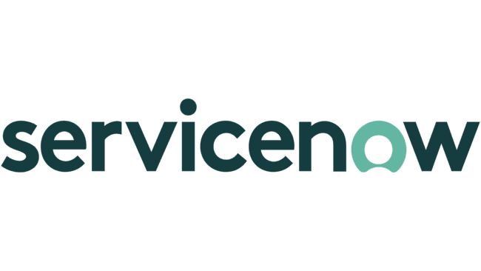



Web Development – Key technologies
In Time Tec – Company Confidential

Slide 3
AEYC-education
Team Size: 30 | Duration: 8+ Years | Active
Project Background:
Association for the Education of Young Children (AEYC) is a non-profit association in US focused on improving the well-being of young children, with particular emphasis on the quality of educational and developmental services for children from birth through age 8 . AEYC provides many different programs to assist professionals who work to educate young children . People who offers facilities for young children education, AEYC supports them with qualified staff, state licenses (if required for facility) etc. AEYC team keeps track of background verifications, trainings of staff and offers scholarship programs. AEYC has various processes and flows where manual, and paperwork was involved which slowed down the process and not easy to maintain the data. They were looking for digital solution.
Solution In Time Tec Offered:
In Time Tec developed RISE web application where they users get all the required features and things were automated and easy to maintain.
Access: Public ; Total Users: 25000+ ; Language Support: English and Spanish ;
Outcome:
RISE Web Application helps AEYC to automate their various process which were manual and time consuming.
RISE application has set of features for facility creation, grants approval, Trainings etc which enables users and AEYC team to get rid of manual and paper-work.
In Time Tec – Company Confidential

Slide 4
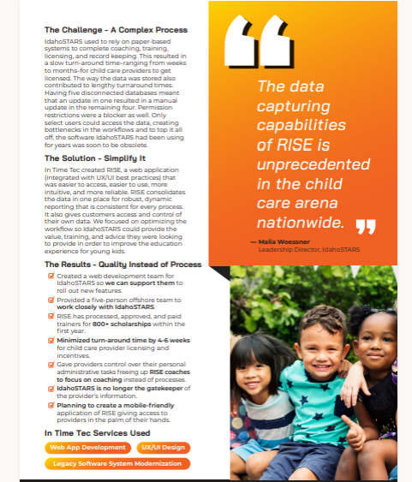

Slide 5
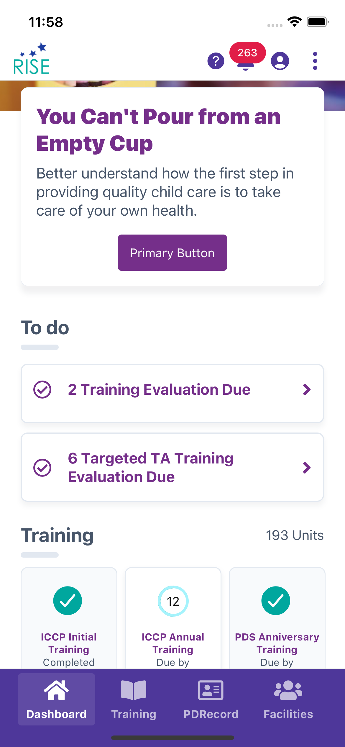
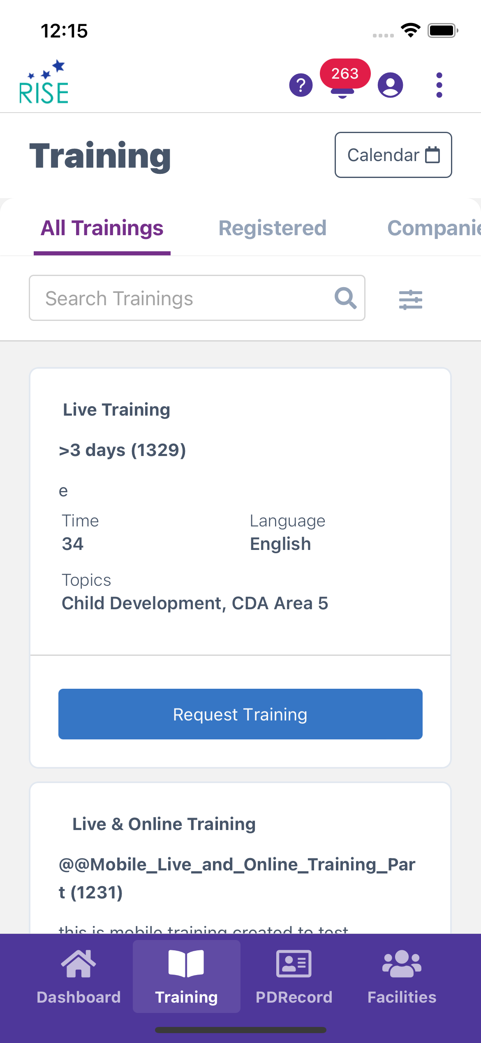
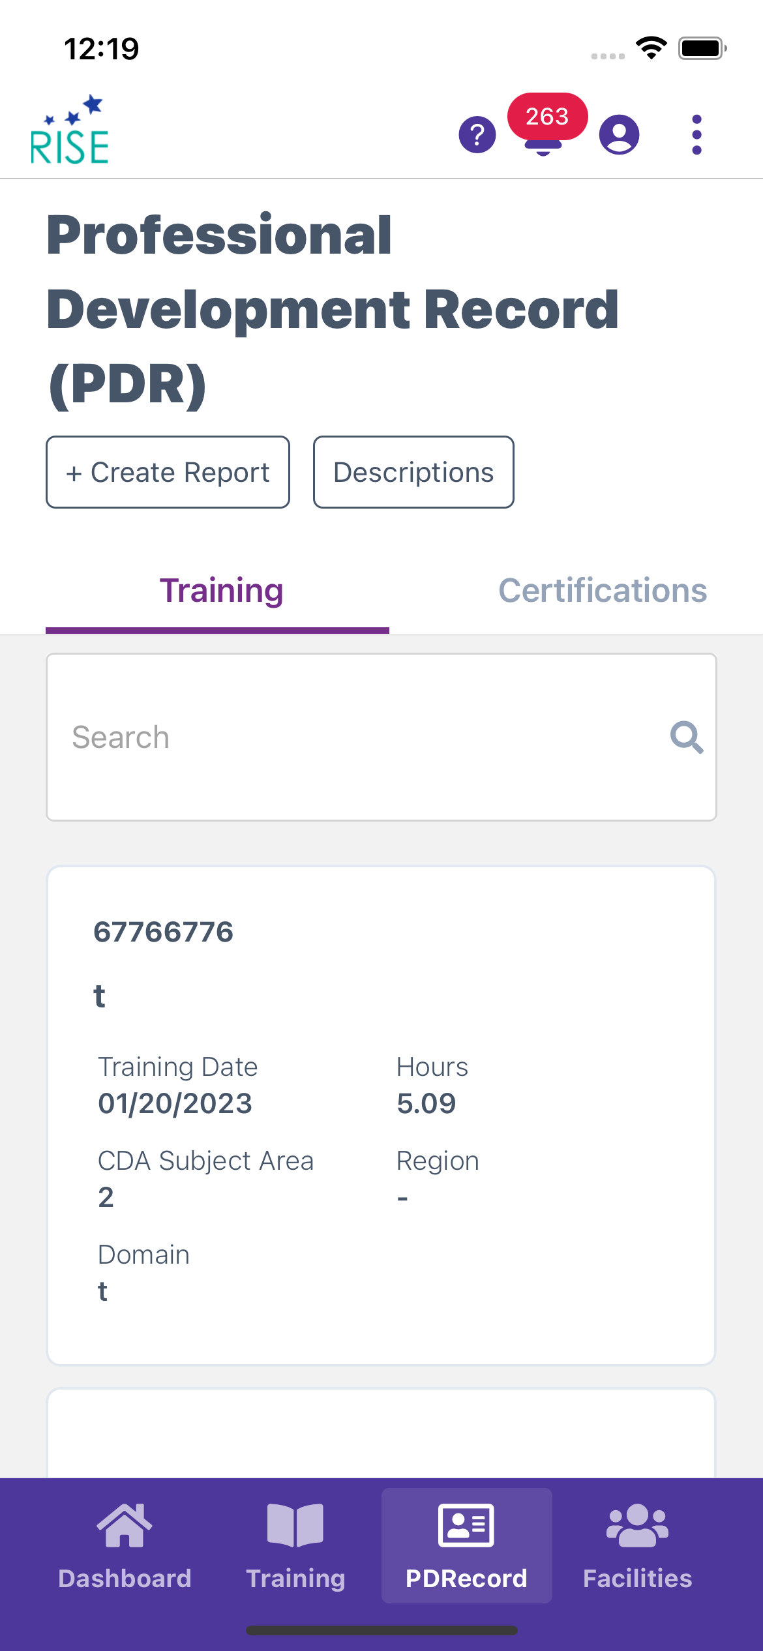
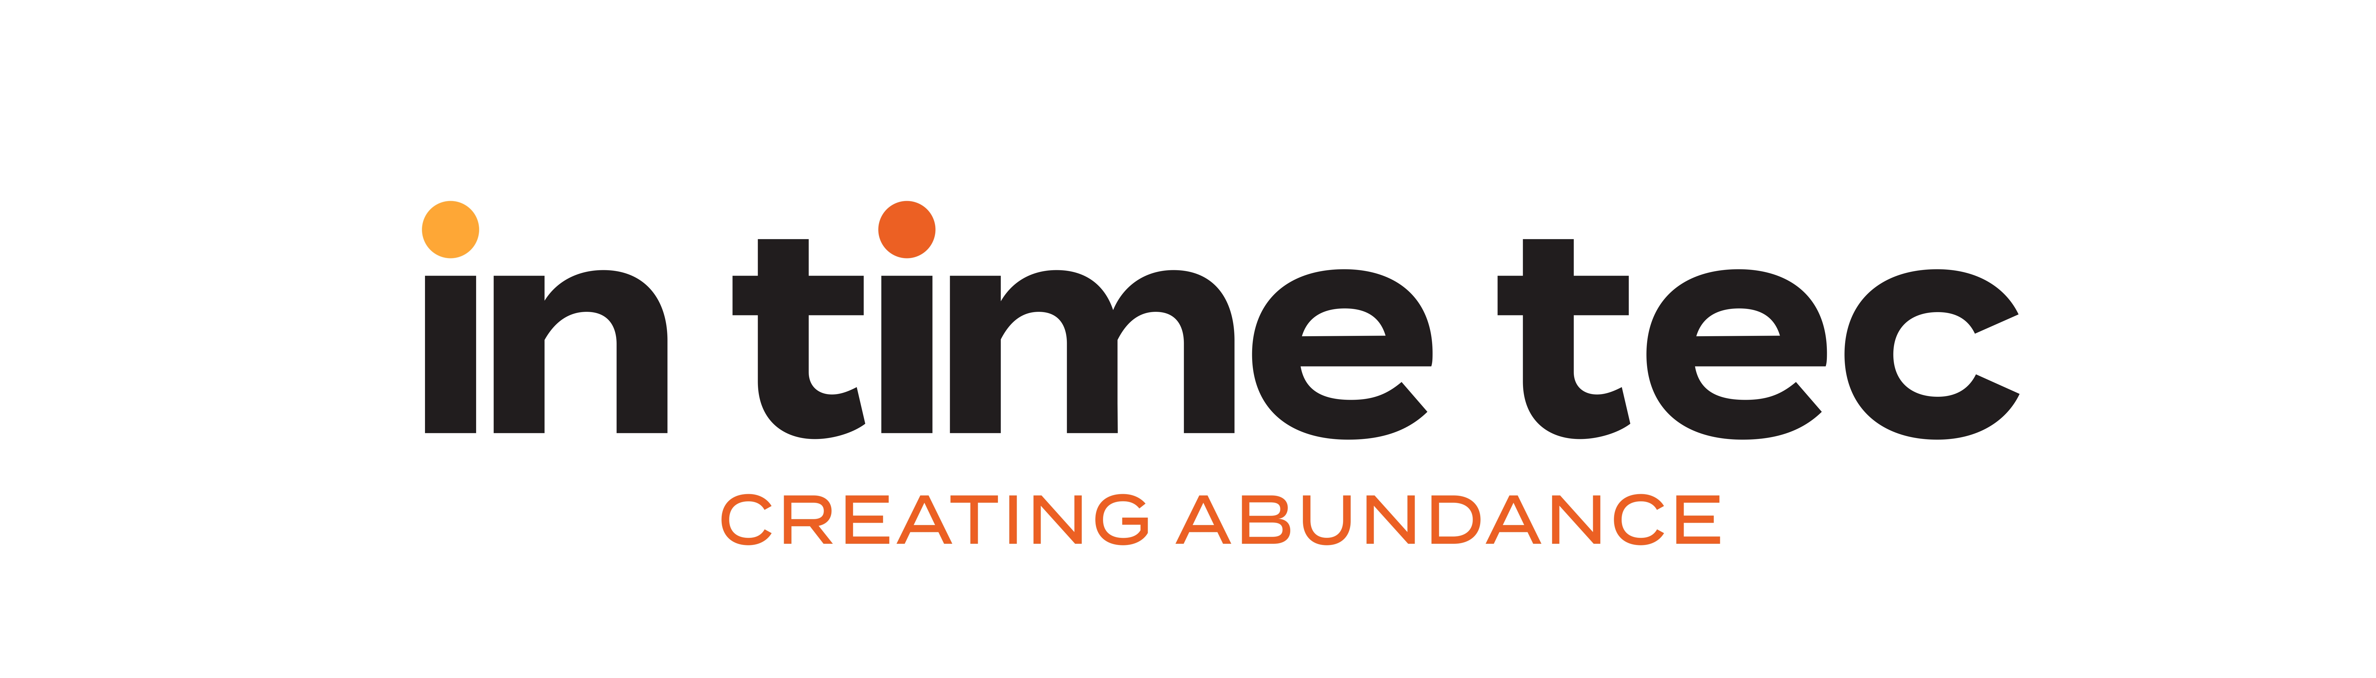
EDUCATION- CASE STUDY 1 (AEYC MOBILE APP)
Key Features:
Dashboard
Banners - Banners are helpful to display the Important information to the Users
Pending Evaluations - Once user register to the training and attended that training, the pending evaluations of that particular training or TTA will be displayed in the dashboard.
Trainings - As a Rise user there are mandatory trainings need to complete.
User can view and register for all the trainings, created by the Idaho stars Trainers. Here we have Two types of Trainings which are Live trainings where it will be held on through the location and second one is online trainings these will be work based on the cloud id.
PDRecord - This is the Professional Development Record from IdahoSTARS. The record has five tabs. View or download any or all of the tabs on your record

Slide 6
BFSI - CASE STUDY 5 (Kount)
Project name: KOUNT| Team Size: 32| Duration: 4+ years | Active
Project Background:
Kount specializes in providing fraud detection software and tools along with preventing account takeover fraud.
They reached out to us for integrating the existing fraud detection software with their clients and to add
Geocoding functionality to classic Kount Mobile SDKs.
Solution In Time Tec Offered: (Mobile SDK Development in ReactNative, Native & Flutter)
[FINANCIAL SECURITY] Our major work started with helping them integrate existing fraud detection software with major card brands Verifi and Ethoca. We focused on adding functionalities like User Behavioural Data capturing to the existing SDKs and to integrate it with the Mobile App's to be used by customers of Kount for Android and iOS platform. We begin the SDK support for Hybrid Apps developed in ReactNative and Flutter frameworks too. We contributed into expanding different ways of distributing Kount SDK's and SDK maintenance. Currently working on SDKs support to Xamarin and .NET.
Access – Internal
Target User Group: Global (Used by clients of KOUNT for fraud detection)
Team Structure – 2 Software Engineers (iOS), 2 Software Engineers (Android), 1 Software Engineer (QA), 1 Software Engineer (SDET)

Slide 7
BFSI - CASE STUDY 5 (KOUNT)
Project name: KOUNT| Team Size: 32| Duration: 4+ years | Active
Outcome:
The integration played a major role in the revenue growth and expanding their merchant line. The portal creation simplified most of the manual work and provided a quick and go to solution to access all the information.
.

Slide 8
RETAIL/eCommerce - SUMMARY
# | Key Clients | Projects
1 | SEBO USA Inc | 1
2 | Fitted USA Inc. | 1
Experience & Expertise (Key Technologies Used)
PHP, Laravel, Shopify, WordPress multisite, DevOps (AWS), QA (manual + automation-performance testing)

Slide 9
SEBO
Team Size: 3 | Duration: 9+ Years | Closed
Project Background:
Client was in retail business for vacuum cleaners in US. They wanted digital presence where potential prospects and customers can buy vacuum cleaners. Also, platform would provide videos / information about their products. They wanted to manage the product catalogues, content through an Admin Panel. SEBO has various websites, its goal is to provide a gateway between client and various end users (Dealers and Non-Dealers) to purchase vacuum cleaners.
Solution In Time Tec Offered:
In Time Tec has developed and maintained an eCommerce website for SEBO to sell vacuum cleaners and spare parts. Our involvement with the projects comes with various responsibilities such as:
Provide site security by making sure all the server components stays up to date.
Provide timely CMS updates to all the sites.
Fulfil any requirement that the clients may have.
Developing custom components for website features.
Total Users: 10000+ ; Access: Public ; Target User Group: Global
Outcome:
Earlier process was manual. In Time Tec helped in digital transformation that helped in increasing market reach and improved consumer engagement.
In Time Tec – Company Confidential

Slide 10
Fitted Running
Team Size: 8 | Duration: 1 Year | Closed
Project Background:
Client was in eCommerce business and sold sports products, i.e., running shoes. Their existing website was developed using WordPress and had multisite feature. They were facing challenges with performance of the website and needed additional features to address business requirements.
Solution In Time Tec Offered:
In Time Tec developed supported with following -
Performance optimization and refinement of existing system. Earlier services were taking very long (48-72 hours). We optimized it to execute in half of the time.
It was a web portal for different stores in US. User can login and order using the web portal. This was created with multisite architecture.
Enhanced the Admin portal which was used to maintain the inventory for various stores and used to provide valuable information about specific products availability to the store admins
Access – Public ; Target Users – Store vendors and buyers in US
Outcome:
End users got benefited by faster, efficient and improved experience of the website. It increased customer retention and new user acquisition ratio.
In Time Tec – Company Confidential

Slide 11
BFSI - SUMMARY
# | Key Clients | Projects
1 | CII (Credit Interlink Inc) | 1
2 | KOUNT (Equifax, Inc) | 1
3 | BCI (Blue Cross of Idaho) | 1
Experience & Expertise (Key Technologies Used)
.NET Core, ASP .NET, Angular, MVC, Python, React JS, GraphQL, GoLang, Android, iOS, AWS, Kubernetes, Docker

Slide 12
BFSI - CASE STUDY # (CII)
Project name: CII | Team Size: 13| Duration: 10+ Years | Active
Project Background: (SPOC - Gaurav)
Credit Interlink produced a requirement to do research and development for their ongoing website. They asked us to do the development and QA for new and legacy work (different kind of verification orders, new third-party integrations etc.) The envisaged web application would be used as platform to verify information related to customers in order to help III parties to process loan applications.
Solution In Time Tec Offered: (Brief Phrase)
Intimetec has provided a work force which helped CII to do research and development along with QA for their new project. We helped in the ongoing projects well. We have provided the support for their major production deployment (encompass roll-out).
Intimetec helped CII to find out the areas where they can do improvements (fax services integrated with Documo) and grow their business.
Intimetec helped processors (CII's internal operations team) to do their job without putting lot of manual efforts by implementing automation and different tools (admin tool, billing tool etc.)
Access: Internal (CII Employees) as well as External
Target User Group: US
Team Structure: 7 Software Engineer (Development) ; 4 Software Engineer (QA) ; 2 DevOps

Slide 13
BFSI - CASE STUDY # (CII)
Project name: CII | Team Size: 13| Duration: 10+ Years | Active
Outcome:
CII is on the leading verification service provider in the market and IntimeTec helped them to grow their business at a level where they have collaborated with bank of England, bank of America, chase bank, wells Fargo, Finicity etc.)
In Time Tec helped in III party integrations which includes – Docusign, Documo, Finicity, TWN (work Number), Equifax, TransUnion and Experian
.

Slide 14
BCI
Team Size: 15 | Duration: 5+ Years | Active
Project Background:
BCI provides Idaho Health Insurance, Idaho Dental Insurance, and Idaho Medicare Advantage in state. We started 5 years back for one of automation project.
Solution In Time Tec Offered:
This is a major Insurance domain client with extensions in other states other than Idaho as well. We started with Automation support and later Web Development work. This is an ongoing project with visibility to continue work to support with compliance and digitization of processes.
Currently we are providing various services to BCI :-
Web Developemnt
Automation SDET work
Compliance work like submitting data to BCBSA
Access – Public ; Target User Group: US
Outcome:
Currently we are saving money with Automation like Mobile automation for them.
By submitting data to BCBSA we have saved lot of money for BCI as it was delayed by 2 years and we have completed this work in 5 months only.
In Time Tec – Company Confidential

Slide 15
IT - SUMMARY
# | Key Clients | Projects
1 | BasicSafe (EHS Hero by BLR) part of Simplify Compliance LLC. | 1
2 | Liiingo | 1
Experience & Expertise (Key Technologies Used)
PHP, MySQL, Javascript, HTML, CSS3, JQuery,Bootstrap, Node.js, React Native, MySQL, Typescript

Slide 16
IT - CASE STUDY 6 (Simplify Compliance)
Project name: BasicSafe | Team Size: 10| Duration: 5 years | Closed
Project Background:
BasicSafe is an internet-based integrated approach to managing safe work cultures and compliance with regulatory requirements. Extensive programming based on proven safety methodologies that target employee training and information access is the backbone of the BasicSafe suite. BasicSafe is built by skilled programmers working with experienced safety managers at companies helping develop this software. They reached out to us for better UI & Usability.
Solution In Time Tec Offered: (Mobile Development – React Native)
We started working with BasicSafe first on UI refinement and they impressed with work which we did on UI refinement.
And along with that we have focus on using cloud services like AWS to solve their problems. And as most of the time the application will be used in sites with low/no network areas. We built as mobile application with React Native with responsive design where it works in both mobile/tablet and that can support all screen sizes.
Access – External
Target User Group: Global
Team Structure – 8 Software Engineers (Development), 2 Qualification Engineers

Slide 17
IT - CASE STUDY 6 (SIMPLIFY COMPLIANCE)
Project name: BasicSafe | Team Size: 10| Duration: 5 years | Closed
Outcome:
Decreased code deployment time with automated CI/CD pipeline
Created mobile application which works seamlessly with or without network
Integrated cloud services like s3 bucket for database/code backups.
Access – External
Target User Group: Global
Team Structure – 8 Software Engineers (Development), 2 Qualification Engineers

Slide 18
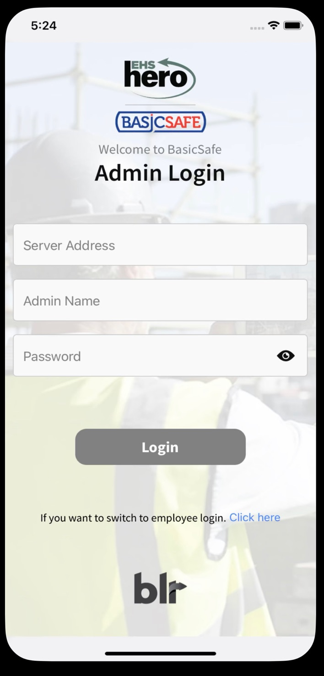
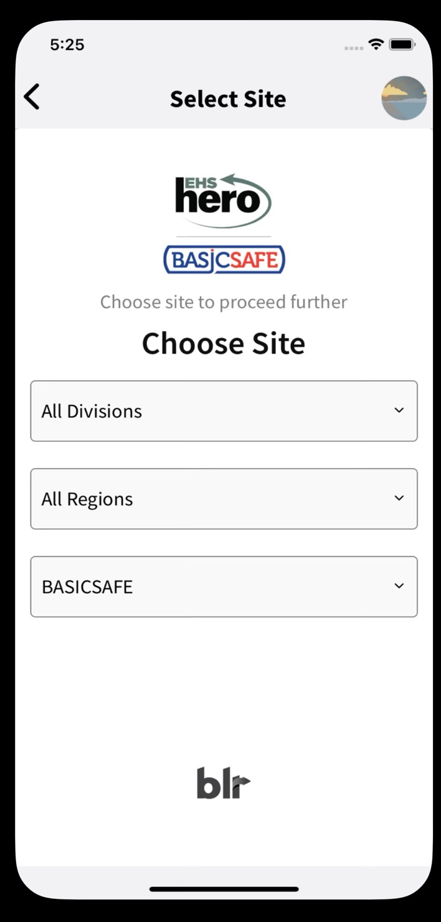
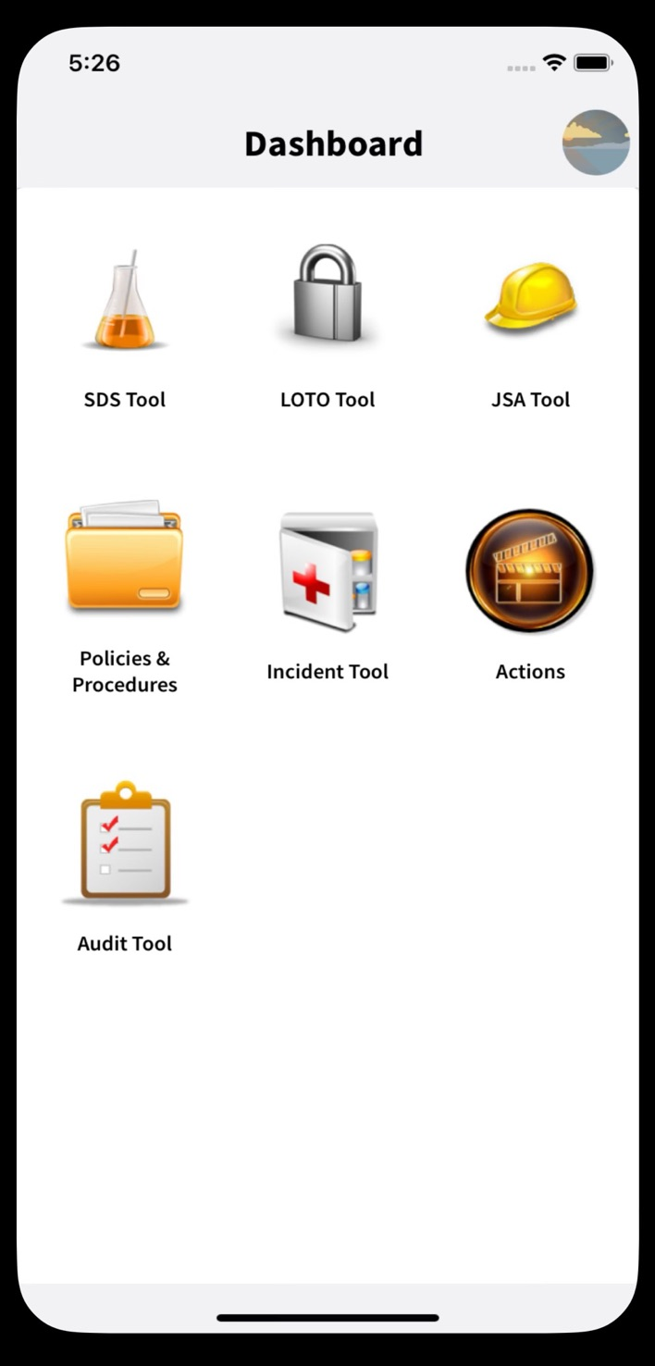
IT - CASE STUDY 6 (SIMPLIFY COMPLIANCE)
Key Features:
Authentication
Barcode scanning
Audit tool
Policies and Procedures tool
Incident tool
JSA tool
SDS tool
LOTO tool
Offline usage
Responsive in all screen sizes
Platform: iOS, Android Technology: (Cross platform) React Native

Slide 19
IT - CASE STUDY # (Liiingo )
Project name: Liiingo | Team Size: 4| Duration: 6 months | Active
B2B - US
Project Background: (SPOC - Neetima)
Liiingo is all about connections. With Liiingo you can: -Engage visitors with interactive information, videos, and graphics -Keep employees up to date with protocol, shift changes, and announcements -and make your company inclusive with smart language detection.
ITT is revamping their web and mobile application with a new UI and existing bug fixes. Also migrating to latest React native versions.
Solution In Time Tec Offered: (Application Revamp)
Liiingo partners with companies to provide customer connection and engagement through it’s web and mobile content platform. Liiingo provides a dynamic links and QR Codes that links a partner’s customers and end users to localized content about a product, a location, or a service.
Our work includes modifying the existing web application so that it works on a variety of user devices, not just mobile phone web browsers. Liiingo desires to provide a web view experience that is appropriate for phones, tablets, laptop and desktop computers, and possibly kiosk and larger devices up to 4K resolution.
Access: Public / Global
Target User Group: US
Team Structure – 1 Tech Lead, 2 Software Engineers, 1 QA

Slide 20
IT - CASE STUDY # (Liiingo)
Project name: Liiingo | Team Size: 4| Duration: 6 months | Active
Outcome:
Consistent UI/UX in different devices. Lesser UI issues. Smooth performance of mobile and web apps.

Slide 21
MANUFACTURING - SUMMARY
# | Key Clients | Projects
1 | Air Products and Chemicals, Inc. | 1
Experience & Expertise (Key Technologies Used)
Angular, .NET, Azure DevOps

Slide 22
Air Products
Team Size: 29 | Duration: 1 Year | Active
Project Background:
Air Products’ objective was to partner with In Time Tec for long term software development services that increase capability and capacity as needed for project completion. In Time Tec has been supporting them with maintenance and upgradation of existing applications, as well as develop a newer version for some of them.
Solution In Time Tec Offered:
We maintain and develop 5 applications under the Air Products client umbrella, which facilitate various workflows in the gas plant management systems. The applications are:
Digital CI: Tool is used to visualize plants, customers, & fuelling stations information within a particular geographical location along with their different properties to produce or transport gases based on carbon intensity.
Reformer Balancing: A process conducted through IATWT tools (which In Time Tec team works on) carried for the plants which collects and process temperature data, runs optimizers through process inputs and maps that creates reports to summarize the findings for a particular plant.
OptiPlus: Tool used to check periodic data of gas pipelines and other machineries in their plants by which they troubleshoot the system and perform optimization, if required.
MPO: (Multi plant optimization) Tool used to provide details about various products, plants and customers across various franchises like Gulf Coast, Alberta, Southern California etc.
Smart View: Tool is used on handheld devices/tablets to monitor time real data from different gas plant monitoring stations. In Time Tec provides database support.
In Time Tec – Company Confidential

Slide 23
Air Products (Continued)
Team Size: 29 | Duration: 1 Year | Active
Outcome:
In Time Tec has given a face lift to some of the existing apps for Air Products and has helped in creating visually attractive, user friendly, dynamic and robust applications.
We are now fully aware of their domain (role of the software applications in a chemical industry) and have been successfully working with the Air Products team in enhancing the overall user experience.
In Time Tec – Company Confidential

Slide 24
Simplot DBA
Team Size: 2 | Duration: 6+ Years | Active
Project Background:
Simplot was looking for capable engineers to handle their databases and maintain them. They mainly wanted us to have a standard defined for the database backup and other maintenance activities for their servers.
Solution In Time Tec Offered:
As per initial requirement ITT was mainly focusing on creating database maintenance plans and defining standards on fewer than 100 Servers. Now, We maintain 400 servers and 4000 databases of the entire Simplot organization. We provide database support for both North American and Australian clients. The team is responsible for the database maintenance, configuration and deployment of new and existing DB servers. We are responsible for any strategic decision on the project level. We configure and maintain the High Availability techniques across the project. We also take part in critical decision-making process along with Simplot team. We provide solutions for various security aspects and end to end support during server migrations or database upgrades.
Outcome:
In Time Tec – Company Confidential

Slide 25
Simplot BI Reporting
Team Size: 7 | Duration: 6+ Years | Active
Project Background
Simplot was looking for migrating their legacy reporting and ETL tools like BRIO, QlikView, Cognos, Web focus to Microsoft stack
Solution In Time Tec Offered:
We are taken end to end responsibility for migrating all the reports from BRIO to SSRS, worked on the administration of the QlikView servers and worked re- architecture of the QlikView servers and migrated 90% of the QlikView reports to Microsoft Power BI, SSRS. We have also worked on migrating the Cognos cubes, SSIS Packages to SSAS, SSIS respectively. Also worked on creating many of the reports in Power BI from scratch. We also provide the support for all the Cognos cube, reports, packages, and SSRS, Power BI, QlikView support
Outcome:
In Time Tec – Company Confidential

Slide 26
Mobile DEVELOPMENT - SUMMARY
# | Business Case Study | Platforms | Development Approach | Industry Domain
1 | Idaho STAR (AEYC App) | Android, iOS | Cross Platform (React Native) | Education
2 | Alert Sense (Communicator App) | Android | Native | Communication
3 | Alert Sense (MyAlerts App) | Android, iOS | Cross Platform (Cordovia-Ionic) | Communication
4 | Skytrace (UBI App | Android, iOS | Cross Platform (Cordovia-Ionic) | Transport
5 | Kount (Kount App) | Android, iOS | Cross Platform (React Native, Flutter), Native | BFSI
6 | Simplified Compliance (BasicSafe) | Android, iOS | Cross Platform (React Native) | IT
7 | In Time Tec PMI Chapter Event | Android, iOS | Cross Platform (React Native) | Events
8 | St Luke's (St Luke's App) | Android, iOS | Native | Healthcare
9 | NGAT (Feedlot Manager App) | Android, iOS | Native | AgTech
10 | In Time Tec (TouchFree MFP) | Android, iOS | Cross Platform (React Native) | Printing
11 | HP (HP Roam App) | Android, iOS | Native | Printing
12 | Life's Abundance (L.A. App) | iOS | Cross Platform (React Native) | Sales

Slide 27
COMMUNICATION - SUMMARY
# | UBI | Projects
1 | AlertSense | 2
Experience & Expertise (Key Technologies Used)
Android, iOS, Cordova-Ionic, Kotlin, .NET

Slide 28
COMMUNICATION- CASE STUDY 2 (ALERTSENSE – 1)
Project name: Communicator App| Team Size: 3| Duration: 2 Years | Closed
Project Background:
Alertsense had a development team and needed an extended team. A web application was already in place and they wanted a mobile app with similar features. In Time Tec started with mobile app development as well as maintenance of their existing web application.
Solution In Time Tec Offered: (Mobile Development – Cross Platform)
AlertSense Communicator fulfils following objectives -
Simplify Crisis & Incident Reporting: Situational intelligence from mobile users, with images/assessments, delivered to automated escalation paths by event type.
Location-based Alerts: Assess safety/status of mobile travellers & site users in a map-selected area. Identify/alert those in harm’s way, while preserving battery life & respecting users’ privacy

Slide 29
COMMUNICATION- CASE STUDY 2 (ALERTSENSE – 1)
Project name: Communicator App| Team Size: 3| Duration: 2 Years | Closed
Outcome:
In Time Tec helped Alertsense in launching their apps. Earlier their apps were internal to their team. Entire process of Go-Live was done by In Time Tec.
Access: Internal
Target User Group: B2B (Internal use within organisations)
Team Structure:
1 Software Engineer (BE Development) ;
2 Software Engineer (Mobile-Native) ;

Slide 30
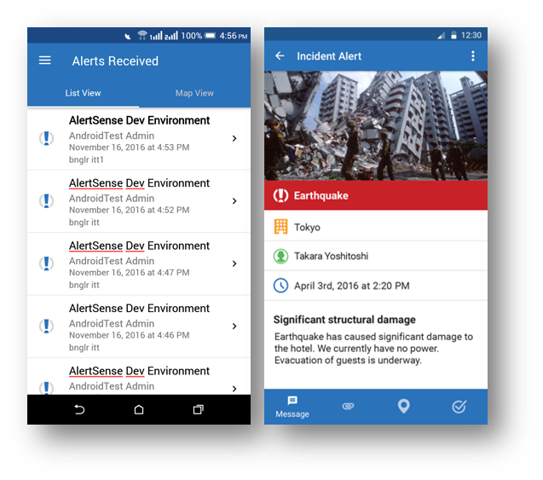
COMMUNICATION- CASE STUDY 2 (ALERTSENSE– 1)
Key Features:
Push Notification
Server-Client REST Connectivity
Map Integration
Create Alerts from App
Upload Media Files
Chat
Platform: Android Technology: Native

Slide 31
COMMUNICATION- CASE STUDY 3 (ALERTSENSE – 2)
Project name: MyAlerts| Team Size: 5| Duration: 5 Years | Closed
Project Background:
Alertsense had a development team and needed an extended team. A web application was already in place and they wanted a mobile app with similar features. In Time Tec Tec started with mobile app development as well as maintenance of their existing web application.
Solution In Time Tec Offered: (Mobile Development – Cross Platform)
•User can receive life-saving emergency alerts from public safety agencies, advanced warning of severe weather and community notifications that impact you and your family.
•Location based alerts with live location monitoring to keep the user updated.
•Alerts include Severe Weather, Public Safety, Community Notifications.

Slide 32
COMMUNICATION- CASE STUDY 3 (ALERTSENSE – 2)
Project name: MyAlerts App| Team Size: 5| Duration: 5 Years | Closed
Outcome:
In Time Tec helped Alertsense in launching their apps. Earlier their apps were internal to their team. Entire process of Go-Live was done by In Time Tec.
Access: Internal
Target User Group: B2C (Internal use within organisations)
Team Structure:
2 Software Engineer (BE Development) ;
2 Software Engineer (Mobile-Cordova Ionic) ;
1 Software Engineer (QA)

Slide 33
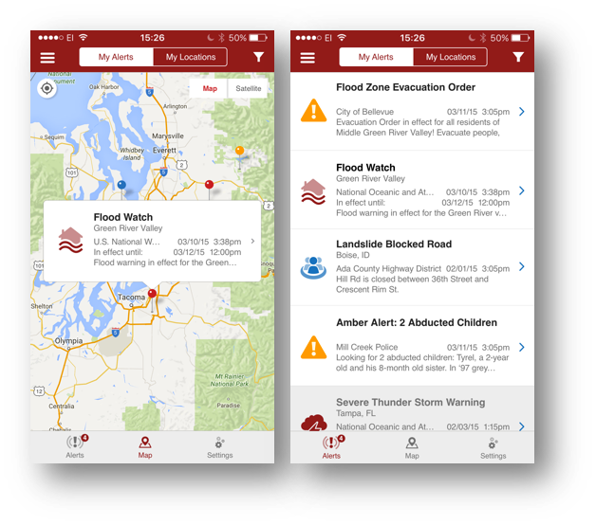
COMMUNICATION- CASE STUDY 3 (ALERTSENSE– 2)
Key Features:
Push Notification
Server-Client REST Connectivity
Location Based Services
Motion Sensors
Map Integration
Platform: iOS, Android Technology: Cross Platform (Hybrid)

Slide 34
TRANSPORT - SUMMARY
# | UBI | Projects
1 | SkyTrace (UBI) | 1
Experience & Expertise (Key Technologies Used)
Angular, Python, Ionic, DevOps

Slide 35
TRANSPORT - CASE STUDY 4 (SKYTRACE )
Project name: UBI App | Team Size: 4| Duration: 5+ Years | Active4
Project Background:
Client needed live tracking for vehicles and sending notifications to the end users for car services and other services.
Solution In Time Tec Offered: (Mobile Development – Ionic)
Developed mobile app as well as web portal for vehicle inventory management and services.
Mobile Application is not Live yet, however client found few customers, and we have given demos to them and this is ongoing, Developed software for managing hardware devices used for live tracking.

Slide 36
TRANSPORT - CASE STUDY 4 (SKYTRACE)
Project name: UBI App | Team Size: 3| Duration: 5+ Years | Active
Outcome:
User who subscribe to the mobile application get notifications for due car services, and they can also track their vehicles live. Vehicle lot can be managed.
Access: External
Target User Group: Global
Team Structure: 2 Software Engineers (Development) ; 1 Software Engineer (QA)

Slide 37
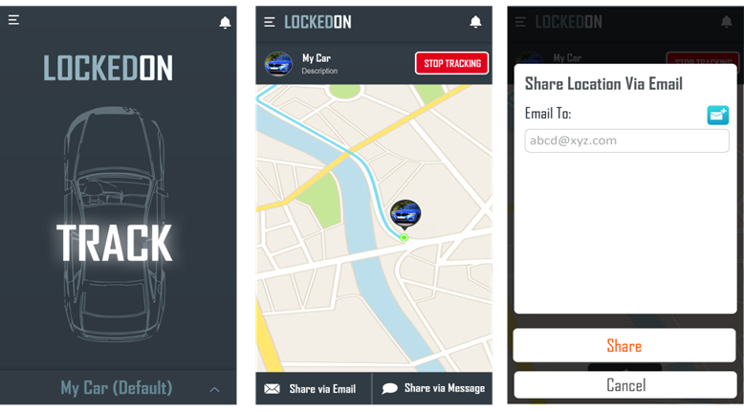
TRANSPORT- CASE STUDY 4 (SKYTRACE )
Key Features:
Live tracking of vehicles
Securing vehicle from thefts
Share live location anytime
Notification of vehicle status
Server-client REST connectivity
Platform: iOS, Android Technology: Cross Platform

Slide 38
EVENTS - SUMMARY
# | Key Clients | Projects
1 | PMI Chapter Event | 1
Experience & Expertise (Key Technologies Used)
Cross Platform

Slide 39
EVENTS - CASE STUDY 7 (PMI CHAPTER EVENT)
Project name: PMI Chapter Event | Team Size: 2| Duration: 3 years | Closed
Project Background:
Ease PDU submission and increase participant engagement at local chapter events with the PMI Chapter Events app. It uses gamification to engage users with sponsors
Solution In Time Tec Offered: (Mobile Development – React Native)
In Time Tec offered following solution via mobile app development that helped the stakeholders in following way -
•Admin: Event organizers can scan and register their attendees using their mobile phones or iPad at the event streamlining the onsite check-in and PMI PDU crediting process.
•User: Event attendees can view and register their attendance using their mobile phone at the event streamlining the onsite check-in and PMI PDU crediting process.

Slide 40
EVENTS - CASE STUDY 7 (PMI CHAPTER EVENT)
Project name: PMI Chapter Event | Team Size: 2| Duration: 3 years | Closed
Outcome:
Participating local PMI chapters use the app to take attendance and submit PDUs for members. Chapter members and guests register for events and even choose conference sessions, where applicable, in the app.
.

Slide 41
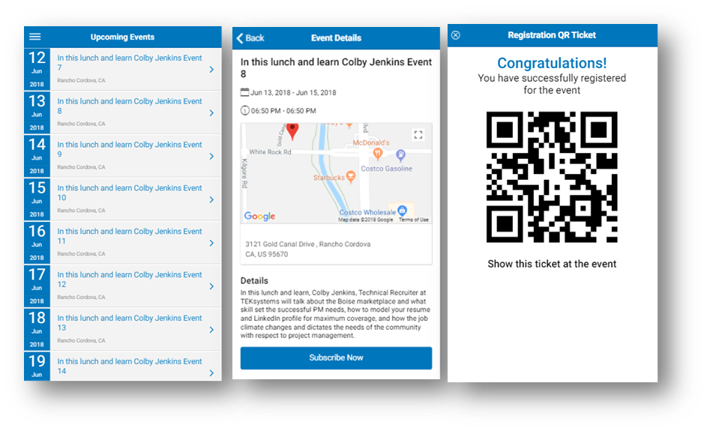
EVENT- CASE STUDY 7 (PMI Chapter EVENT)
Key Features:
Server-Client REST Connectivity
Event Attendance
Event Details & Location
Event Calendar
QR Scanner / Generator
Platform: iOS, Android Technology: Cross Platform

Slide 42
AGTECH - SUMMARY
# | Key Clients | Projects
1 | NGAT (Feedlot Manager) | 1
Experience & Expertise (Key Technologies Used)
IOS, ReactJS, .NET, Azure

Slide 43
AGTECH CASE STUDY 8 (NGAT)
Project name: Feedlot Manager App | Team Size: 14.5| Duration: 2+ years | Active
Project Background:
Next Gen/Ag Tech offers tech innovation to the agriculture industry by allowing feedlot managers to track cattle shipments, manage feedlots, and finance cattle using cloud software. Feedlot Manager is product of NextGen AgTech.
Solution In Time Tec Offered: (Mobile Development – Native)
Cattle Country Capital app is a solution for tracking finance data of cattle for various feed lots. CCC helps in cutting paperwork and multiple spreadsheets required for managing cattle and related finances. CCC has multiple software applications to cover lifecycle of livestock from procurement, animal husbandry involving feeding, rationing, health and reporting, and transportation for further processing in the cattle supply chain.
In Time Tec has developed the product and releasing MVP version in 2023. Mobile App is expected to be published on itunes this year.

Slide 44
AGTECH CASE STUDY 8 (NGAT)
Project name: Feedlot Manager App | Team Size: 14.5| Duration: 2+ years | Active
Outcome:
App has been tested in production environment. Development work is ongoing and not published on itunes yet.
.
Access – B2B (Customers subscribing for NGAT)
User Group: US
Team Structure –
2 Software Engineers (Development-Backend),
2 Software Engineers (iOS)
1Software Engineer (QA)​

Slide 45
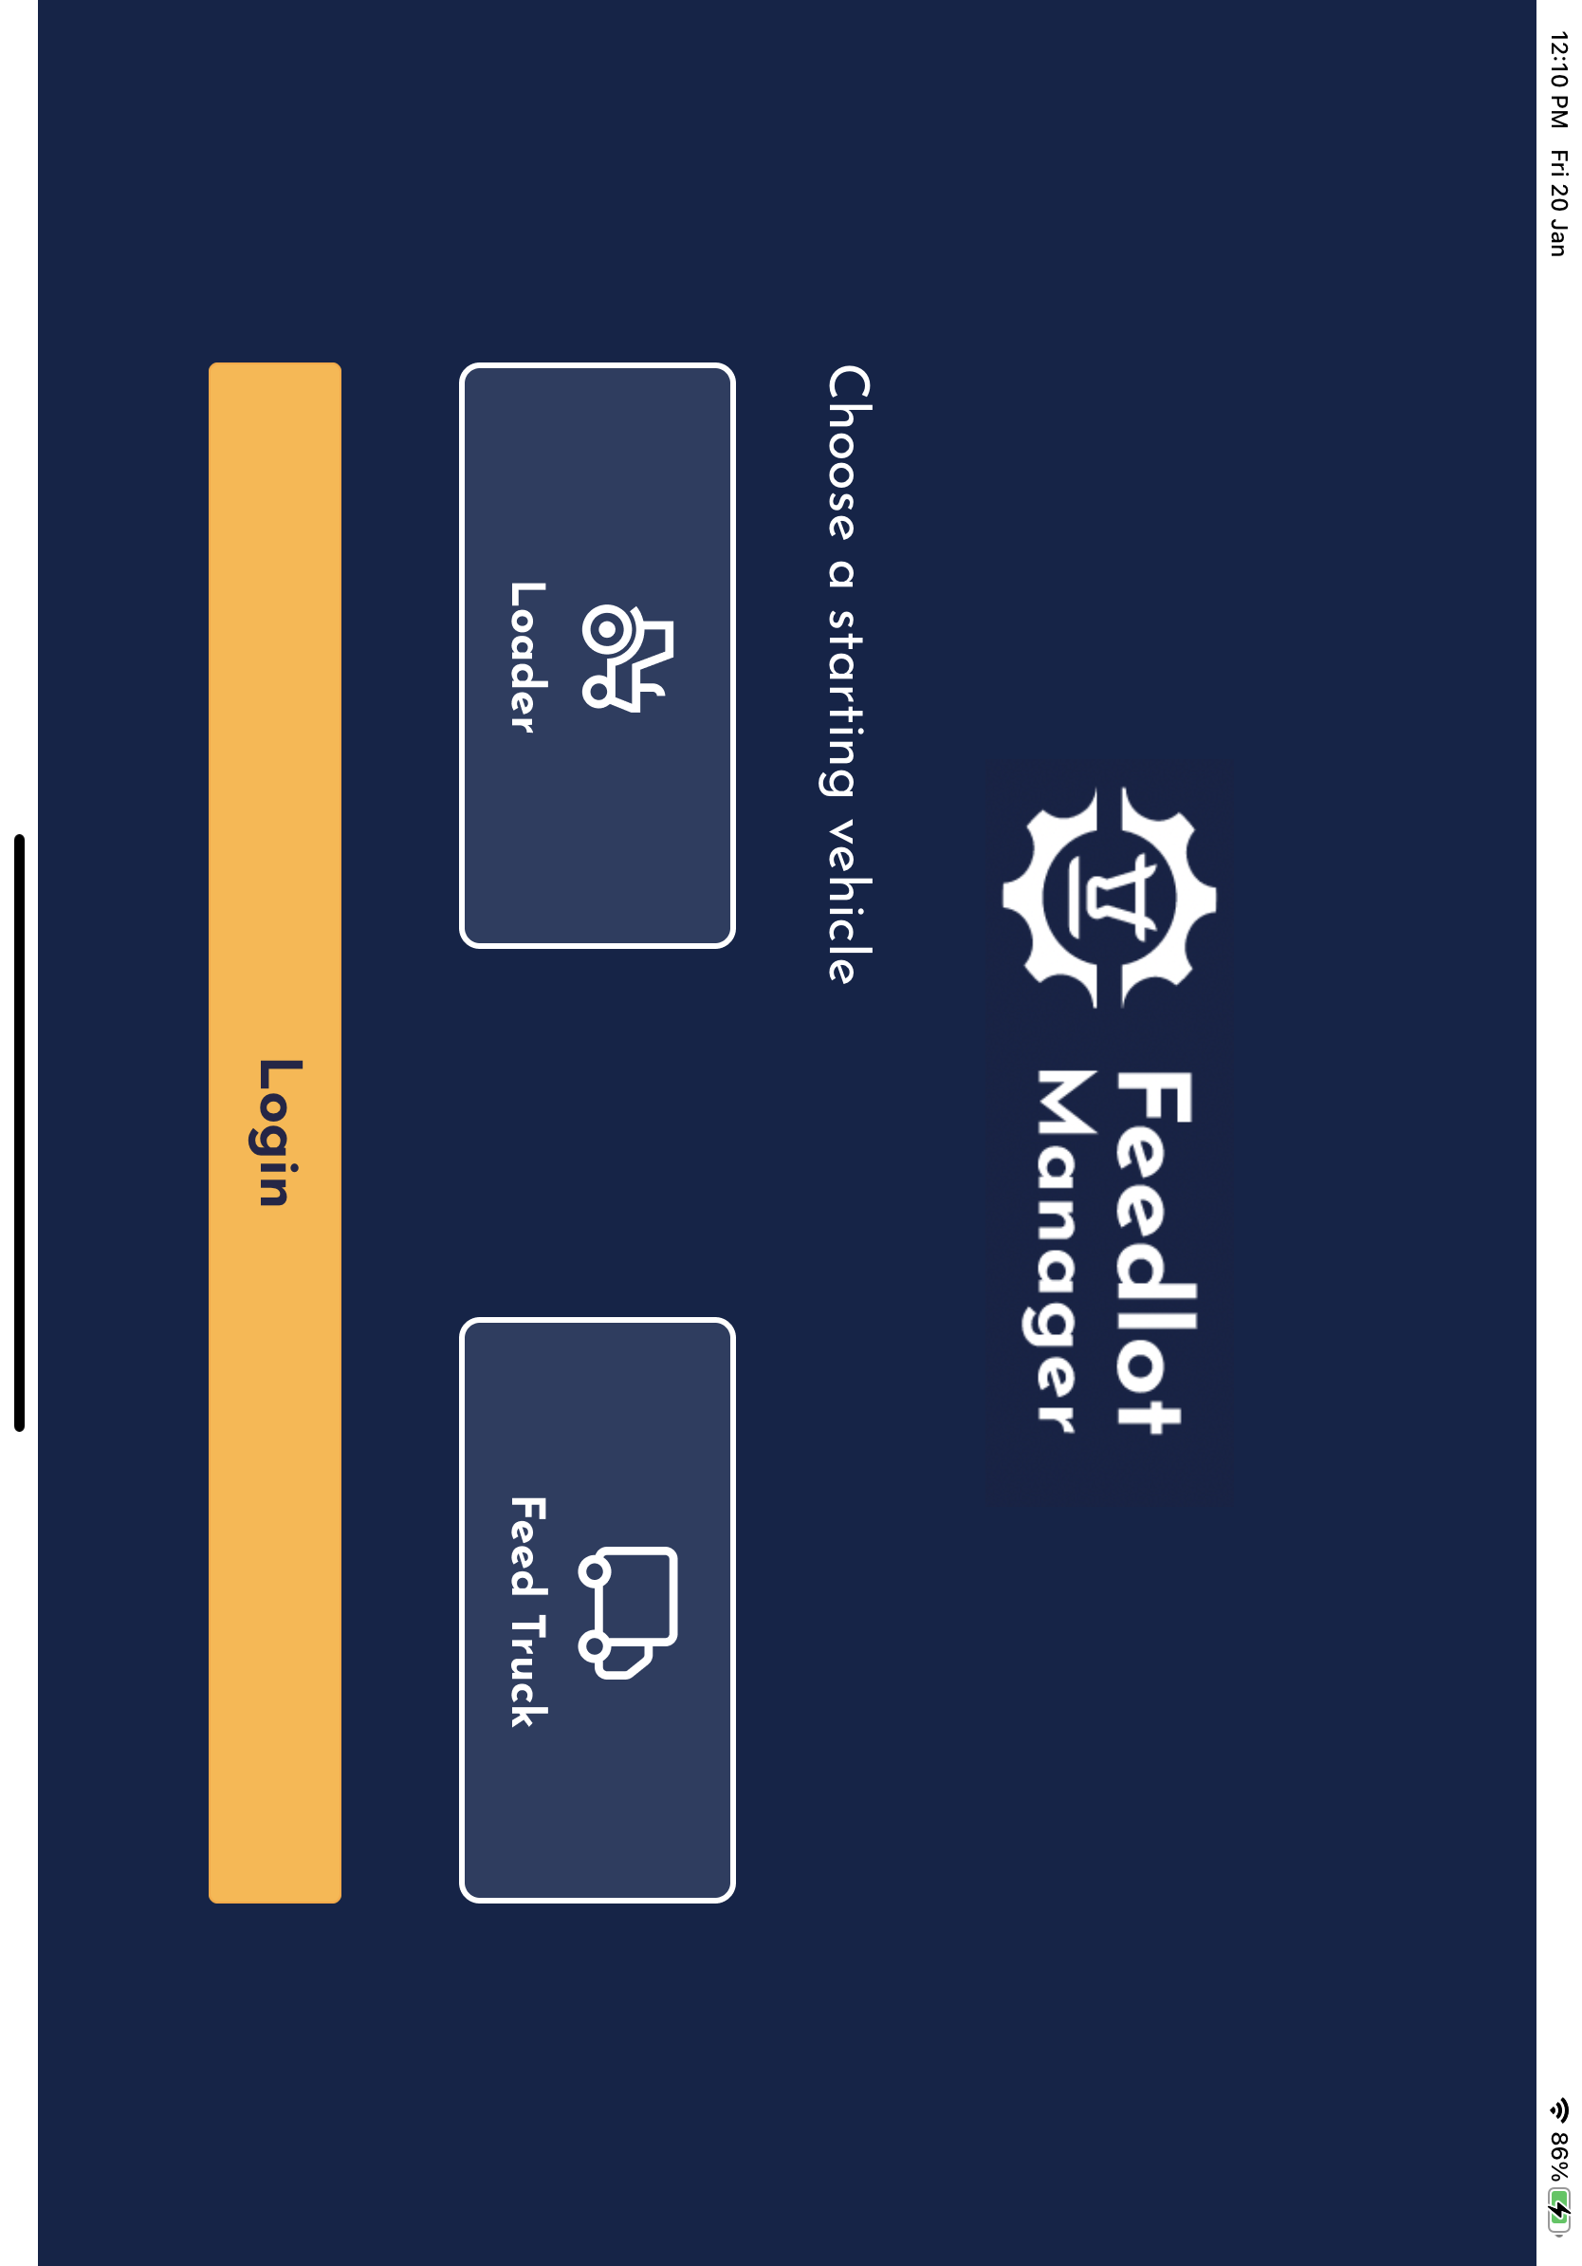
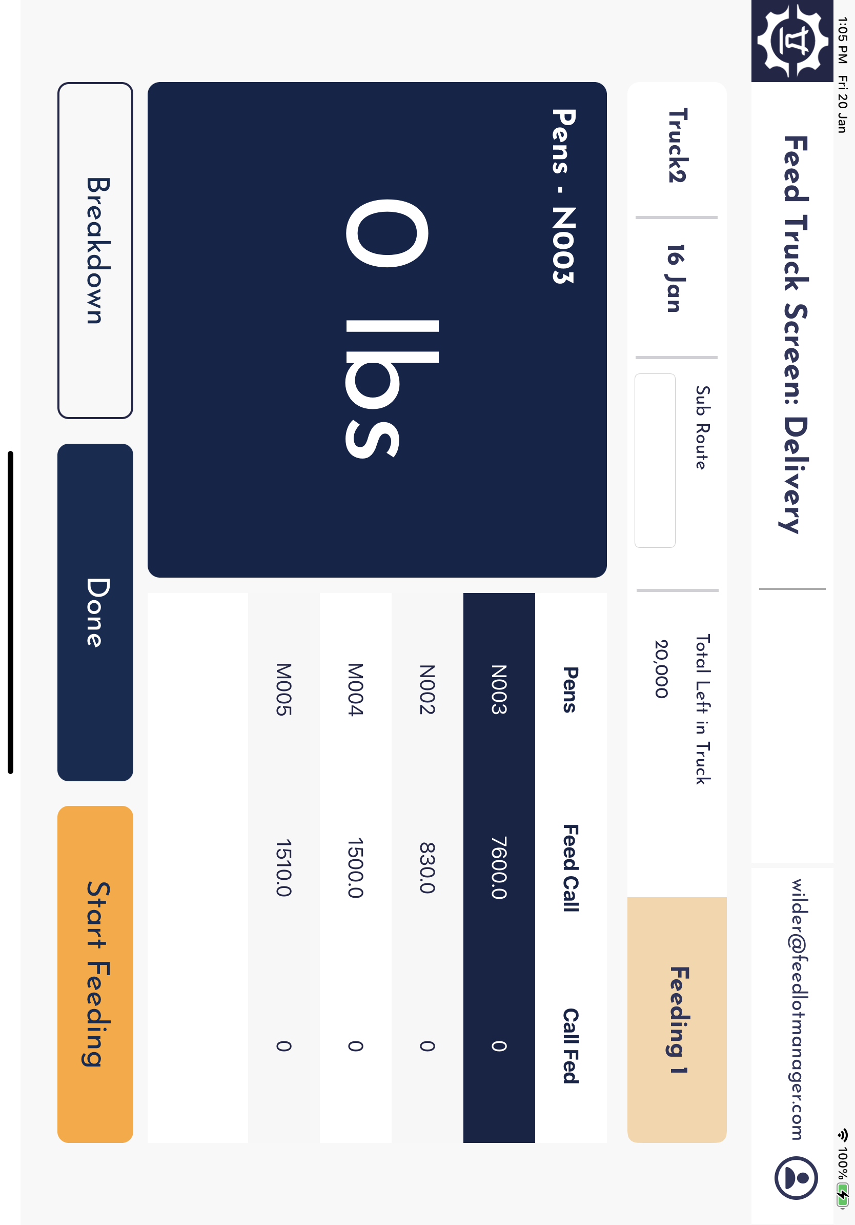
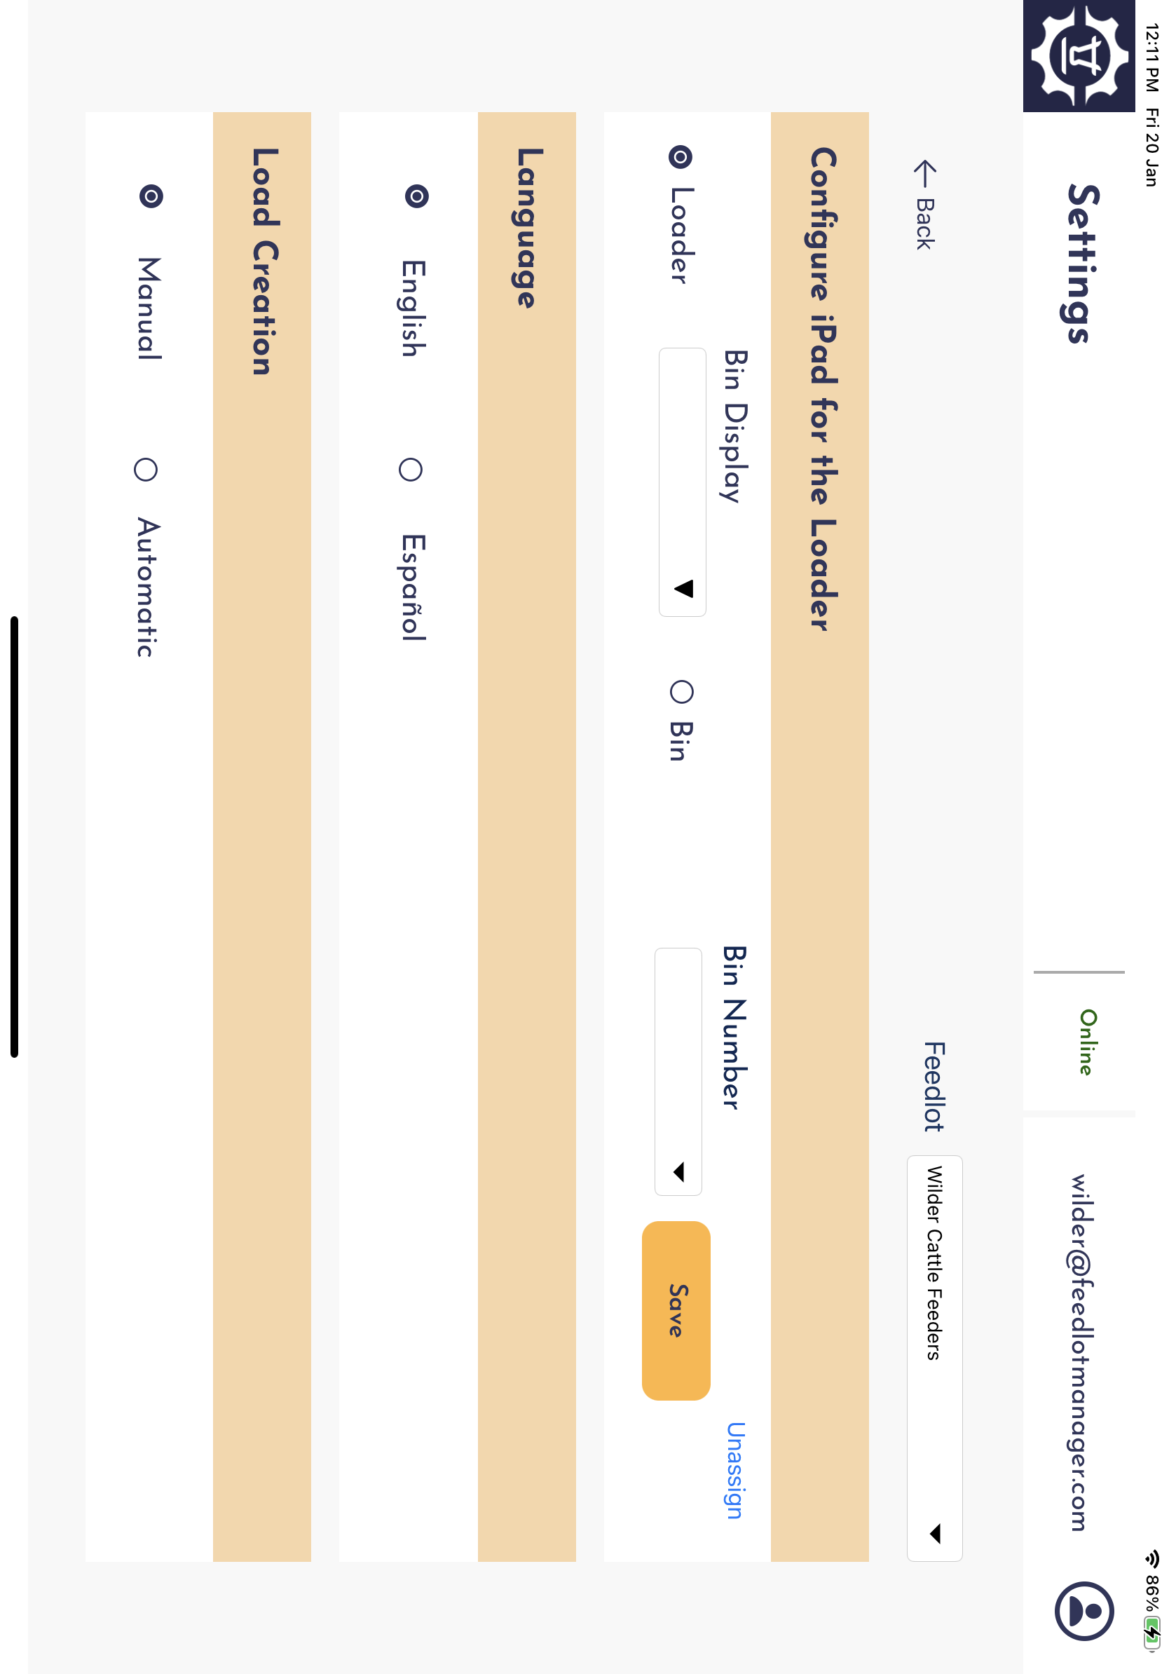
AGTECH CASE STUDY 8 (NGAT)
Key Features:
Login as Loader or Truck Driver
Select Ration to load in truck
Monitor delivery of ration to pens.
Real time loading and delivery of ration
Platform: iOS (iPad) Technology: Native

Slide 46
HEALTHCARE - SUMMARY
# | Key Clients | Projects
1 | St Luke's Hosptial | 1
Experience & Expertise (Key Technologies Used)
IOS : Swift Android : Kotlin Backend API: .NET Third Party Api to fetch Provide and location : Talix

Slide 47
HEALTHCARE - CASE STUDY 9 (St Luke's)
Project name: St Luke's Health System | Team Size: 8| Duration: 2 Years | Active
Project Background:
Mobile app (iOS+Android) for major healthcare provider of Idaho. Has features like Find Providers (Search by name, specialty or Keywords). We can search provider in Family Medicine, paediatrician and urgent care. Find Location by name in same family medicine, urgent care and emergency care. Provide Feedback to app admin.
Solution In Time Tec Offered: (Mobile Development - Native)
In Time Tec app to support following features -
Help users find nearby Hospitals in St. Luke’s network
Help users find nearby Specialty Doctors in St. Luke’s network
Get details about Hospitals and Doctors
Access personal medical records with integrated MyCharts
Pay medical bills with Visit Pay.

Slide 48
HEALTHCARE - CASE STUDY 9 (ST LUKE'S)
Project name: St Luke's Health System | Team Size: 8| Duration: 2 Years | Active
Outcome:
St Luke's hospital was not having a mobile app earlier. In Time Tec helped in bringing experience for their patients on mobile platforms. It is of great use for the patients as it is earlier to get important information about doctors, hospitals and medical help.

Slide 49
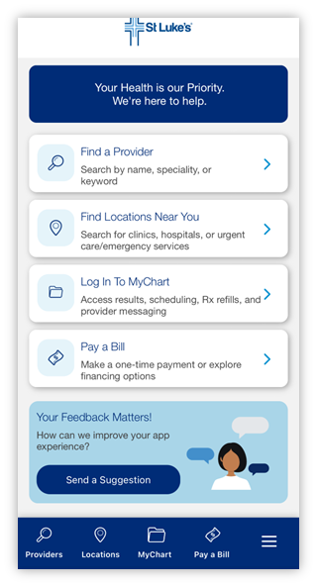
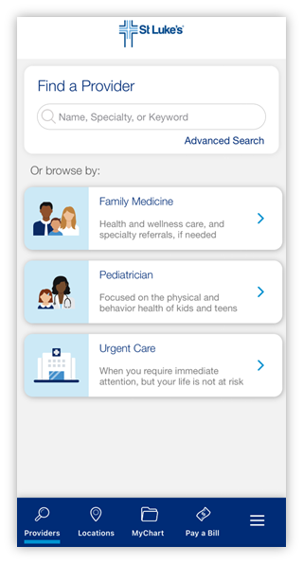
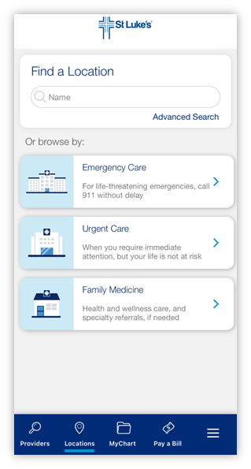
HEALTHCARE - CASE STUDY 9 (ST LUKE'S)
Key Features:
Find Nearby Hospitals
Find Nearby Specialty Doctors
Pay Bills
Access Medical Records
Platform: iOS, Android Technology: Swift, Kotlin
Access:
Target User Group: Global
Team Structure:
6 Software Engineer (Development) ; 2 Software Engineer (QA)
(*5 Mobile App Developers ; 1 BE Developer)

Slide 50
PRINTING - SUMMARY
# | Key Clients | Projects
1 | HP, Inc. | 1
Experience & Expertise (Key Technologies Used)
Android, Kotlin, iOS, Swift, Java, DevOps, API Automation

Slide 51
PRINTING - CASE STUDY 10 (TOUCHFREE MFP)
Project name: TouchFree MFP | Team Size: #| Duration: # Years | Closed
Project Background: (SPOC-Riddhi)
During the pandemic, In Time Tec realized that most industries were focusing on touchfree experience. This was was a result of an idea to create touchless experience for printers and MFPs.
Solution In Time Tec Offered: (Mobile Development – React Native)
In Time Tec developed mobile app that supports following features -
Remotely control compatible HP printers and multi-function devices through your phone on the same network.
PRINT any supported document on your phone.
SCAN documents and save them to your phone without touching the MFP control panel.
SHARE your scanned documents anywhere your phone can share
COPY documents without touching the MFP control panel.

Slide 52
PRINTING - CASE STUDY 10 (TOUCHFREE MFP )
Project name: TouchFree MFP | Team Size: #| Duration: # Years | Closed
Outcome:
With Touchfree MFP App, users no longer need to worry about touching a printer or scanner control panel again. With this app, they can remotely control compatible HP printers and multi-function devices through their phones.
Access: External
Target User Group: Global
Team Structure: 4 Dev 1 QA

Slide 53
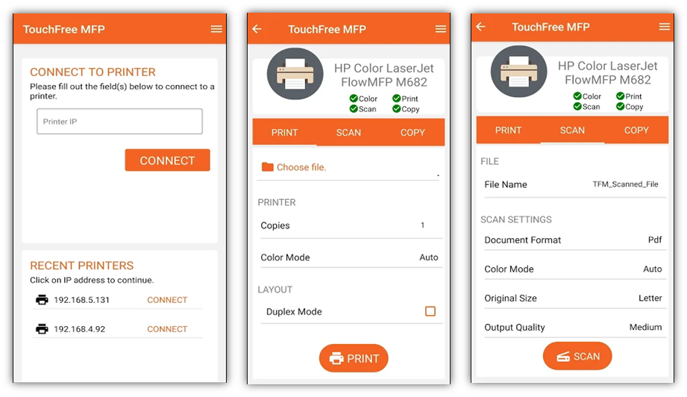
PRINTING- CASE STUDY 10 (TOUCHFREE MFP)
Key Features:
Remote Print, Scan, Copy
Share scanned documents
Touchless access
Multi Printer Support
Platform: iOS, Android Technology: Cross Platform

Slide 54
PRINTING - CASE STUDY 11 (HP)
Project name: HP Roam | Team Size: 25+| Duration: 2+ Years | Closed
Project Background:
HP Roam was a mobile app which was designed and developed for Roam Printing (print from anywhere). Later it was enhanced and supported by In Time Tec. It was an ambitious project for HP.
Solution In Time Tec Offered: (Mobile Development – Native)
In Time Tec developed certain features in collaboration with HP. We majorly did the qualification work for entire project. This includes setting of the framework, creation of working pipeline to promote code to production
API Testing
UI Testing
DevOps
Work we have done - mostly fixed bugs, Fees feature, Taxability feature, Diselematic feature, Payrix feature.

Slide 55
PRINTING - CASE STUDY 11 (HP)
Project name: HP Roam | Team Size: 25+| Duration: 2+ Years | Closed
Outcome:
HP Roam App helped to accomplish following -
Print effortlessly from any device, virtually anywhere, to any HP printer—securely through the cloud
Mobile professionals can now print at virtually any time, from virtually any location and device. Print jobs are submitted to the cloud as users create or consume content.
Prints can then be securely retrieved from any enabled device in the office, at a home office, or at a growing number of public print locations.1 There's no need to worry about device-to-printer compatibility or connectivity
Access: External
Target User Group: Global
Team Structure: 5 Software Engineer (Development) ; 20 Software Engineer (QA)

Slide 56
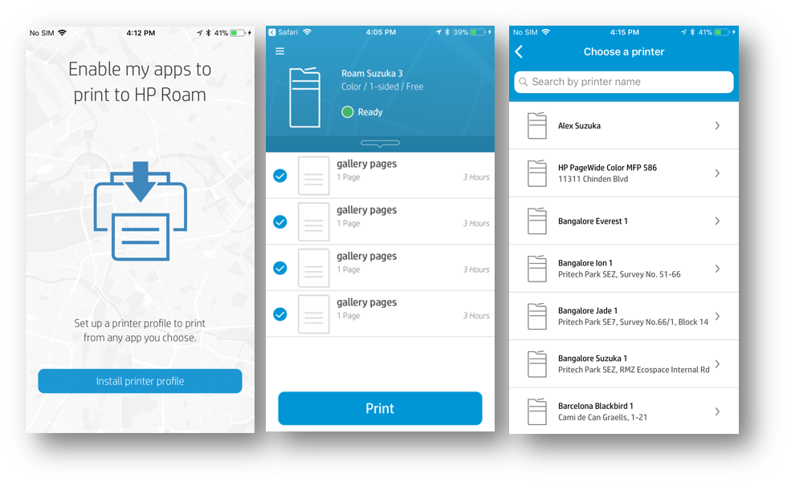
PRINTING- CASE STUDY 11 (HP – #/#)
Key Features:
BLE Nearby Search
Map Integration
Location Tracking
Server-Client REST Connectivity
Platform: iOS, Android Technology: Native

Slide 57
SALES - SUMMARY
# | Key Clients | Projects
1 | Life's Abundance | 1
Experience & Expertise (Key Technologies Used)
React Native

Slide 58
SALES - CASE STUDY 12 (LIFE's ABUNDANCE)
Project name: Life's Abundance App | Team Size: 5| Duration: 8 months | Active
Project Background: (SPOC-Vijaya)
Life's Abundance products are made for people and pets (dogs and cats). They already have an existing website. They wanted a mobile app for their sales team so that sales team is updates about volume of sales and commission on sales.
Solution In Time Tec Offered: (Mobile Development – React Native)
In Time Tec developed first phase of the application that has following features -
Salesperson can login and rest username/password
Salesperson can view sales commission and volume of sales
Salesperson can set notifications based on time (weekdays, weekends, month-end, or never)
Above features are completed and first version is released.
Development is ongoing, and next update will include history and features are being discussed with client.

Slide 59
SALES - CASE STUDY 12 (LIFE's ABUNDANCE)
Project name: Life's Abundance App | Team Size: 5| Duration: 8 months | Active
Outcome:
Enable sales team with visibility of sales volume and commission history. App development is ongoing and feedback from actual users (salesperson) is awaited.
Access: Internal
Target User Group: US
Team Structure: 3 Software Engineer (Development) ; 1 Software Engineer (QA) ; 1 Technology Consultant

Slide 60
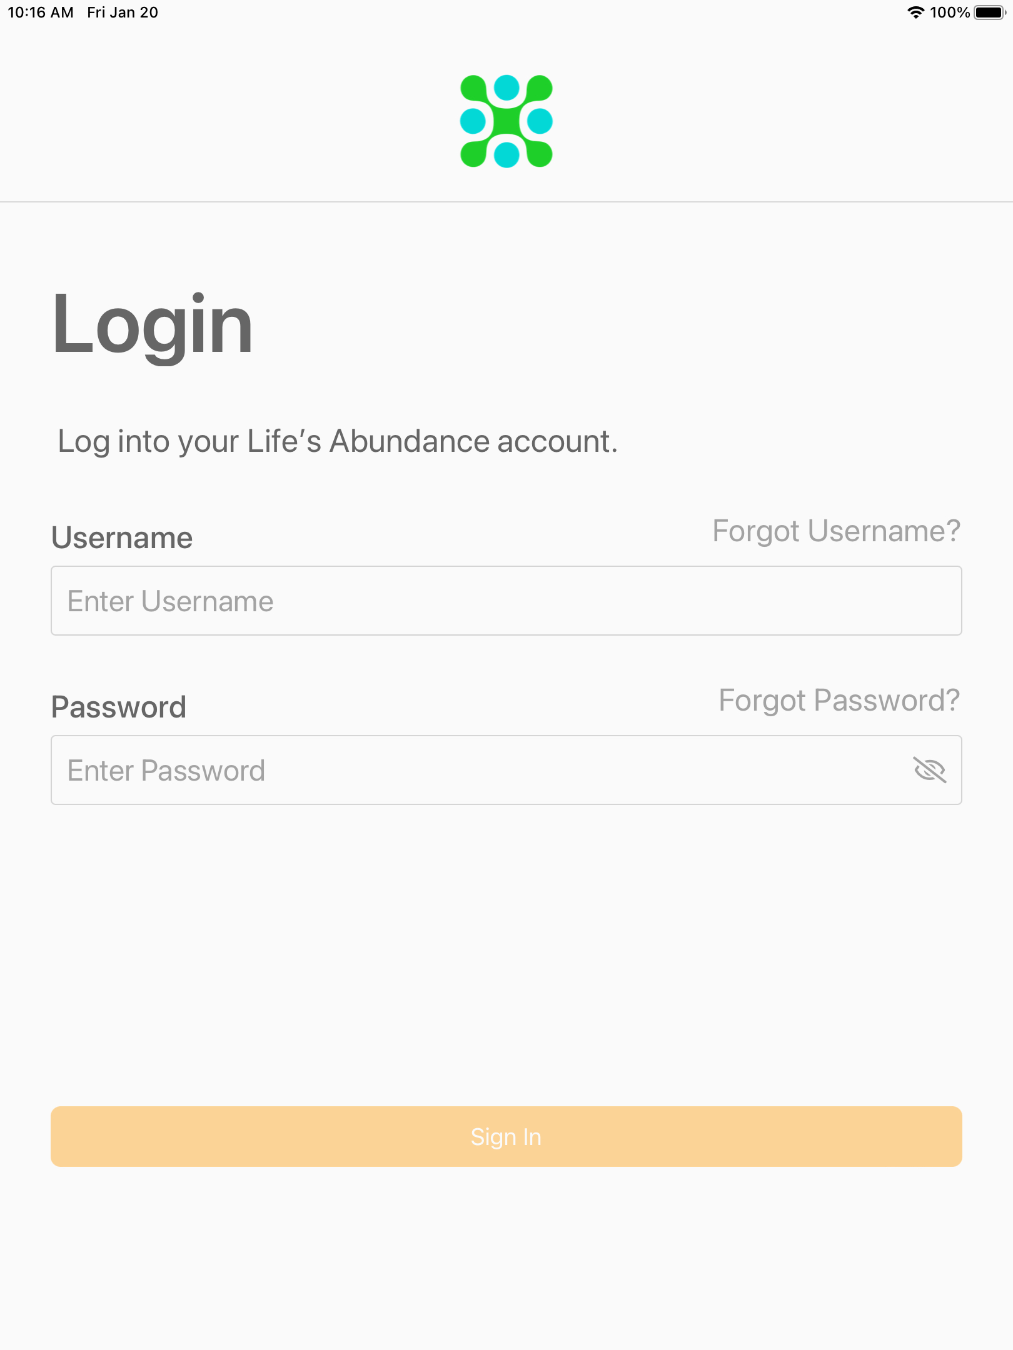
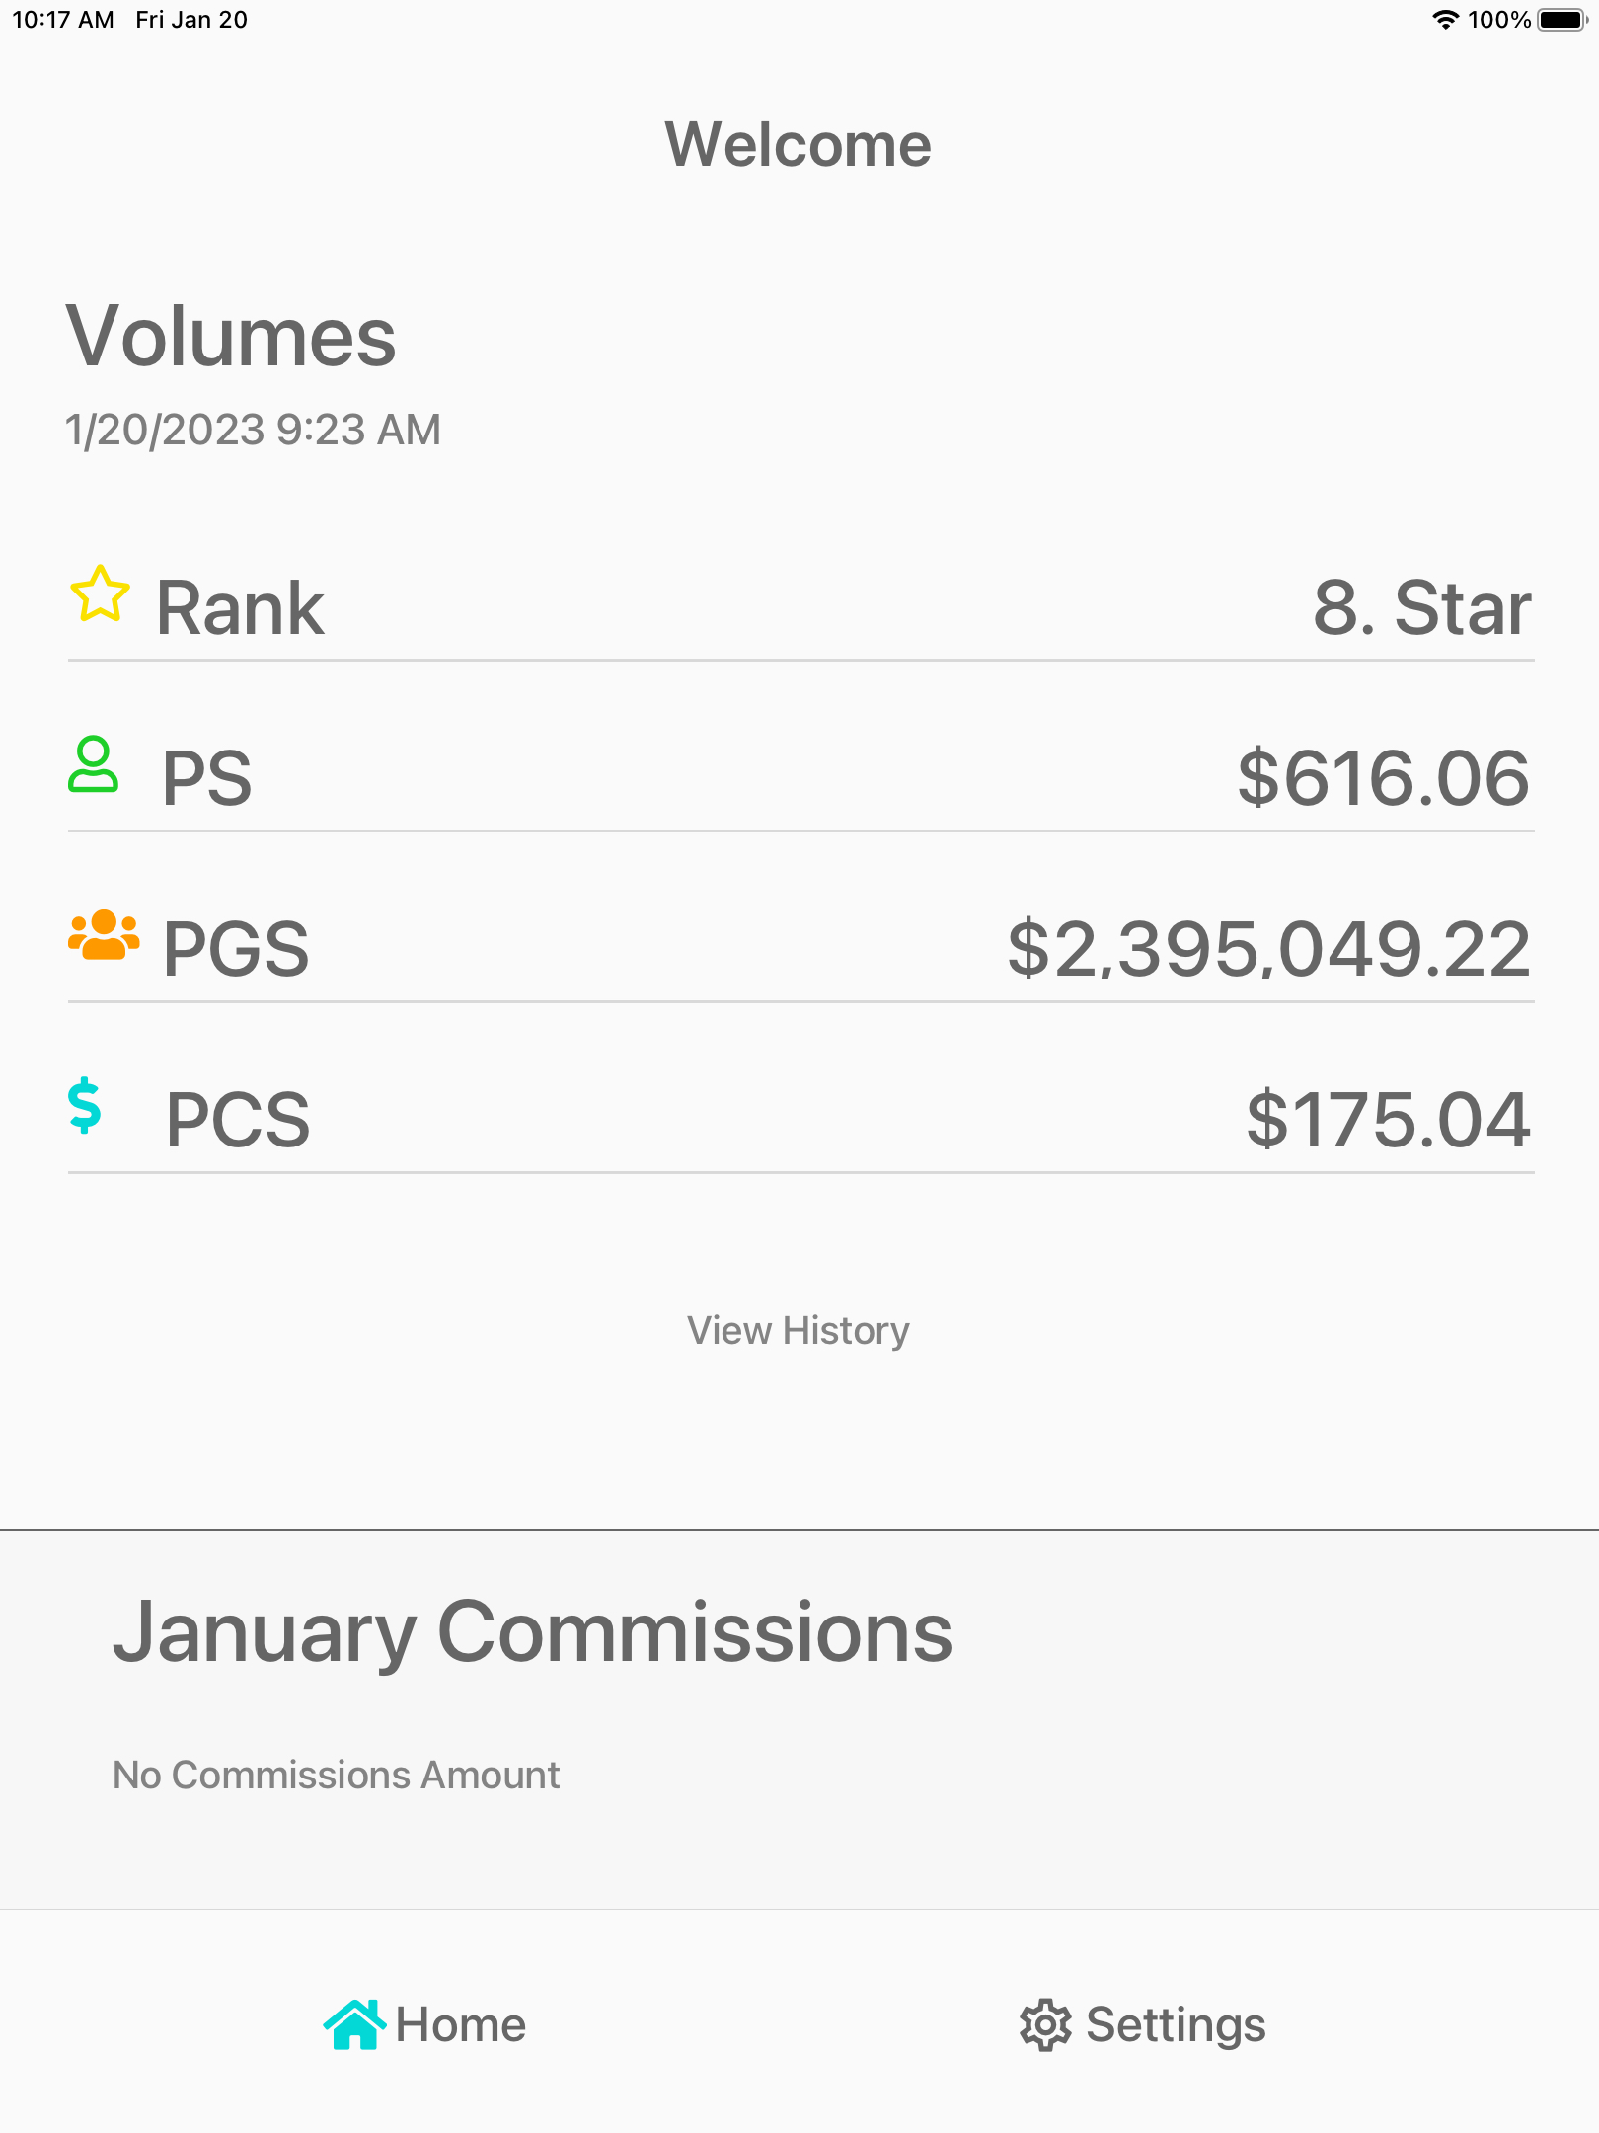
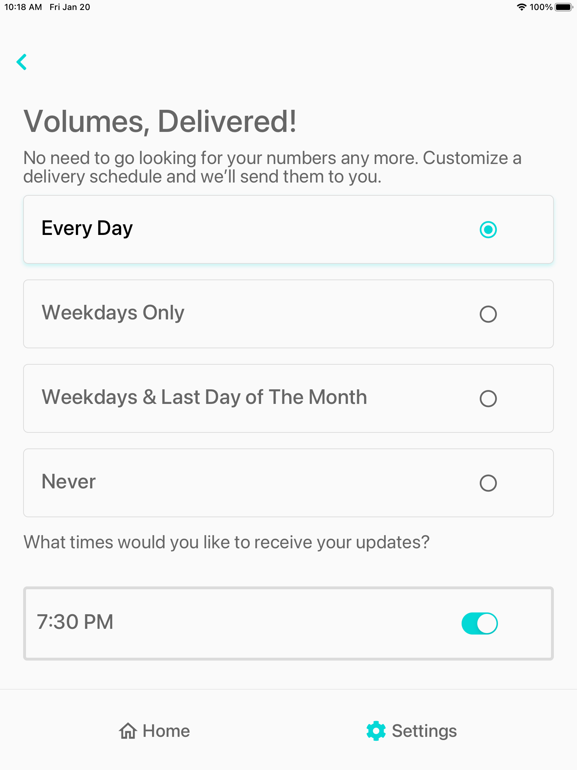
SALES - CASE STUDY 12 (LIFE's ABUNDANCE)
Key Features:
Login / Forget Username/Password
Information on Sales Commission / Sales Volumes
Push Notifications – Settings to receive
Platform: iOS Technology: Cross Platform (React Native)

Slide 61
SalesFORCE - SUMMARY
Line Item | Client | Domain | Total Projects
1 | Global Logic | IT | 4
2 | Simplot | Agriculture | 4
3 | Ferry International | Education | 2
4 | Truckstop | Transport | 1
5 | Balsam Brands | Retail | 2
6 | Cradlepoint | Computers | 1

Slide 62
Salesforce Case Study 1 – Global Logic -1/4
Project Background:
Client is a global provider of professional IT services and solutions which includes product design and development. Opportunity (Sales leads/deals) renewal is maximum portion of business, but Opportunity renewal was manual, there were chances of missing creating renewal Opportunity causing issue in getting accurate data.
Note- Opportunities are deals in progress. Opportunity records track details about deals, including which accounts they're for, who the players are, and the amount of potential sales. If your Salesforce admin has set up leads in your Salesforce org, an opportunity is created when a lead is converted.
Solution In Time Tec Offered: Opportunity Renewal Process Automation
Automated the Opportunity renewal using scheduled process that will occur just before 90 days of agreement expiration date on an Opportunity.
Outcome:
No manual process and enabled business team take proactive action by creating renewal Opportunity before agreement expires and provided accurate data for in a clicks.
In Time Tec – Company Confidential

Slide 63
Salesforce Case Study 1 – Global Logic -2/4
Project Background:​
Delivery team was using excel sheet to calculate options of team composition and ramp up plan while negotiating with client/prospect. This data was not utilized efficiently for future purposes and maintaining data in excel sheet is tedious job.
Solution In Time Tec Offered:​ Customization & Optimization of Project Planning & Resourcing Process
Built a customize solution to estimate team composition and staffing plan, to calculate Labour and Project Margin for Opportunity right in the system. Also provided additional functionality of loading estimate details using XLS template. Loading functionality was improved and helped in reducing time to fetch data. For example: 1000+ staff can be loaded within a minute. These estimate details can be exported and shared with customers as a quote.
​
Outcome:​
Average creation to completion time for quotes improved. Accurate planned data that helps for analysis of planned vs actual.
In Time Tec – Company Confidential

Slide 64
Salesforce Case Study 1 – Global Logic -3/4
Project Background:​
Sales team was facing challenge to prepare reports and charts externally that was needed for Sales heads and management.
Solution In Time Tec Offered:​ Custom Dashboard & Structured Reporting
Built customized dashboards upon business need using Einstein Analytics. Created Sales Dashboard to provide an overview of key performance indicators to Sales team. Created Dashboards to show a projection of business for the next 2 years, Sales Trending analysis using waterfall representation, Customized Leaderboard dashboard to show the performance of Sales reps and Service Offerings Open pipeline to showcase sales based on offerings.
​
Outcome:​
Removed repetitive process of external chart preparation and have all dashboards at single place.
In Time Tec – Company Confidential

Slide 65
Salesforce Case Study 1 – Global Logic -4/4
Project Background:​
Move complete business process to Salesforce from deal creation to Invoice. As currently different functionalities distributed across multiple systems including Oracle ERP.
Solution In Time Tec Offered:​ Salesforce implementation
Customizing the PSA package provided by FinancialForce.
Salesforce provides solutions to overcome the challenges client was facing with Oracle ERP and other systems.
​
Outcome:​
There were restrictions, challenges and limitations client was facing with Oracle ERP / other systems being used
Single system to manage complete process from deal creation to Invoice (In Progress)
In Time Tec – Company Confidential

Slide 66
Salesforce - CASE STUDY 2 (SIMPLOT –1/3)
Project Background:
*Org Merge (They were using two different salesforce prod for different countries)
*An org merge is the process of combining one or more production instances of Salesforce.
Solution In Time Tec Offered: Merging two Salesforce instances into one
⦁ Merging both orgs and according to region employees started using them.
Org Merge Offered different types of solutions. Which includes:
Migration of all metadata, users, and their permissions into the first environment.
All objects and their fields and record types have been migrated to the merge environment.
The purpose of this project: Was to move all users and necessary configuration from the SAPL org into the NA org. This was not a trivial task and took a lot of effort to complete.
Migration Strategy Used:
The way we migrated metadata, users, and data is by using a Big Bang approach. This approach helped us to complete migration efficiently.

Slide 67
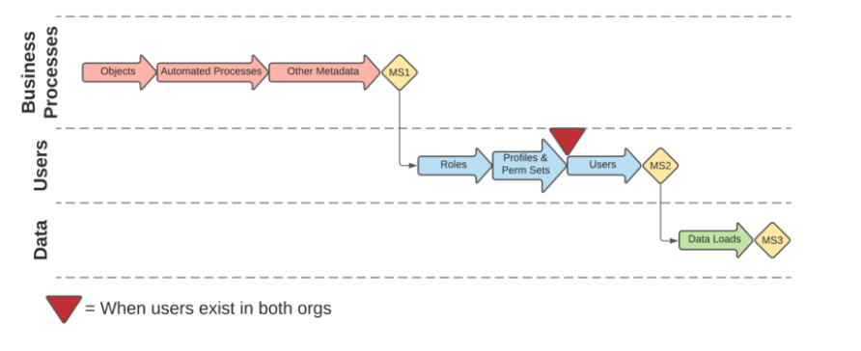
Salesforce - CASE STUDY 2 (SIMPLOT –1/3)
Org Merge Flowchart
Outcome:
⦁ Cutting Maintenance Overheads: No need to maintain two salesforce orgs for one company

Slide 68
Salesforce Case Study 2 – Simplot -2/3
Project Background:
Simplot wanted to have digital experiences to connect with customers, partners, or employees. Users can use 'help forum', support community and other web pages to manage accounts and invoices.
Solution In Time Tec Offered: Experience Cloud Implementation
⦁ Experience Cloud Usage(Implementation) - It helps to deliver connected digital experiences — fast. Reinvent the customer experience, engage more customers, and accelerate growth across any industry with data-driven sites, portals, and mobile applications.
Outcome:
⦁ Proper digital experience connected to CRM.
In Time Tec – Company Confidential

Slide 69
Salesforce Case Study 2 – Simplot -3/3
Project Background:
⦁ Simplot wanted to manage Pricing for products and Rebate on product according to history of customer. That includes Approval automation from higher authorities and other automation processes. (We are implementing idea. Solution for using CPQ was offered from Salesforce team )
Solution In Time Tec Offered: CPQ Implementation
⦁ Provided a solution to speed up their sales process and generating quotes, orders and contracts.
Outcome:
⦁ Made the process easy and quicker for rebate on product as per history of customer. Note: CPQ is an abbreviation of configuring, price, and quote. It is an extension of the Salesforce CRM, and its purpose is to speed up the sales process and make it easier. CPQ is a native unit of Salesforce that is responsible for the automation of generating and processing quotes, orders, and contracts
In Time Tec – Company Confidential

Slide 70
TRANSPORT - SUMMARY
# | Key Clients | Projects
1 | Truckstop | 2
2 | Fullbay | 1
3 | Skytrace | 1
Experience & Expertise (Key Technologies Used)
.NET, PHP Manual QA C#, Rest Sharp, Selenium Salesforce, Provar, Angular, Python, Ionic, ReactJS, Automation

Slide 71
TRANSPORT - CASE STUDY #1 (TRUCKSTOP – #1/2)
Project name: TRUCKSTOP | Team Size: 80| Duration: 3+ Year | Active
Project Background: (SPOC-Gnanaraj)
Client is in logistics business involving brokers and carriers. They were already using a web application. They expected In Time Tec to enhance the existing application and do the qualification work
Solution In Time Tec Offered:
Truckstop is a leader in transportation technology and freight matching solutions. Truckstop offers logistics solutions for transportation professionals through load planning, transportation management, real-time rates, and negotiation tools, as well as the largest industry credit reporting entity helping industry professionals find trusted freight partners.

Slide 72
TRANSPORT - CASE STUDY #1 (TRUCKSTOP – #1/2)
Project name: TRUCKSTOP | Team Size: 80| Duration: 3+ Year | Active
Outcome:
After In Time Tec took over, there was improvement in quality and many additional features were added. Testing was automated that help in saving time and increased speed of execution.

Slide 73
TRANSPORT - CASE STUDY #2 (TRUCKSTOP – #2/2)
Project name: RMIS | Team Size: 50| Duration: 1.5 Years | Active
Project Background: (SPOC-Prasun)
Truckstop (Client) had acquired (RMIS). They started integrating RMIS into Truckstop. They are doing sales and wanted our team to help with generating accounts / web view for clients of Truckstop and do the qualification work.
Solution In Time Tec Offered:
Team is responsible for truckstop new product acquisition RMIS, which is insurance domain and responsible for onboarding new client carriers.
Started with a lean team of 3 developers to start up and later team expanded to 20+ developers and 30 QA engineers supporting the project.

Slide 74
TRANSPORT - CASE STUDY #2 (TRUCKSTOP – #2/2)
Project name: RMIS | Team Size: 50| Duration: 1.5 Years | Active
Outcome:
Improved sales and quicker onboarding for clients of Truckstop.

Slide 75
TRANSPORT - CASE STUDY #1 (FULLBAY #1)
Project name: FULLBAY Size: 12| Duration: 1 Year | Closed
Project Background: (SPOC-Kuldeep)
Fullbay is based on PHP technology and an existing Web Application was in place. Fullbay is cloud-based shop management software built specifically for heavy-duty repair shops. Client wanted new features implemented in their existing website. They needed help with implementation of business logic (calculations and billing).
Solution In Time Tec Offered:
In Time Tec helped client with development of features such as clock management, simplified invoicing, inventory monitoring, streamlining reports etc, and UI changes on the existing website.
Access: External
Target User Group: US
Team Structure: 9 Software Engineer (Development) ; 3 Software Engineer (QA)

Slide 76
TRANSPORT - CASE STUDY 1 (FULLBAY – 1)
Project name: FULLBAY Size: 12| Duration: 1 Year | Closed
Outcome:
Client's sales processes got streamlined. Required features got added on to their website.

Slide 77
Salesforce Case Study 4 – Ferry International 1/2
Project Background:
Client is a real estate coaching company. They provide training, motivating and coaching services by teaching lead generation and conversion techniques. They offer one-on-one coaching, experiential training events, and online productivity products as well as sought-after speakers for exclusive events.
They needed an app for administrative users to access real time data about potential system problems, reporting deprecated metadata, users and licences.
Solution In Time Tec Offered: Built one stop platform for all kind of administrative activities
Lightning app for admin users where they can access real-time categorized org and object limits data, Login activity of users and helping admins to figure out if licenses can be freed up.
Outcome:
It helped the System Administrators and other stakeholders with decisions like designing solutions for new requirements and managing user licenses.
In Time Tec – Company Confidential

Slide 78
Salesforce Case Study 4 – Ferry International 2/2
Project Background:
Security and Access Clean up: Simplifying user profiles and permission sets and redesigning of Security Model.
Solution In Time Tec Offered: Refinement of Design
The ITT team figured out profiles and permissions are redundant and making admins difficult to figure out what to access to give what user. Redesigned the security model to remove access checks in the code to efficiently use the out of box security solutions provided by salesforce.
Outcome:
This helped admins to determine easily what profile to be assigned to users and what additional permissions to be given and users having exactly what access they need.
In Time Tec – Company Confidential

Slide 79
Salesforce Case Study 5 – Balsam Brands -1/2
Project Background:
For an oversize product, there are multiple cartons per package, and the same number of shipments are generated with the labels and BOL, which costs the business team at least $200 per box to return.
Solution InTimeTec Offered: Salesforce Implementation
A single shipment was implemented for multiple packages with a single bill of lading with custom apex code by making use of zenkraft APIs.
Outcome:
Helps business reduce Significant FedEx billing costs.
In Time Tec – Company Confidential

Slide 80
Salesforce Case Study 5 – Balsam Brands -2/2
Project Background:
It was difficult for users to have a look at the transactions and interactions made by a customer with the company. And users want to see all the details on a single page to help service the customer better.
Solution InTimeTec Offered: 360 Degree View of Customer Data
Implementation Customer 360⁰ using salesforce Lightning solutions and Duplicate Data Mangement
Outcome:
Helps save the users time and improve UX and serve their customers faster and better.
In Time Tec – Company Confidential

Slide 81
Salesforce Case Study 6 – Cradlepoint
Project Background:
Bring Cradlepoint's Partners and Employees together on a single platform as part of Cradlepoint Connect initiative
Portal was responsible to provide a place where partners can share deal information with employees, create support cases and access latest knowledge articles
Solution In Time Tec Offered: Salesforce Community Cloud
Salesforce Community Cloud was used with Customer Community License instead of Partner Community License.
Features were implemented using Apex and Visualforce pages.
Look and feel of portal was completely changed from Salesforce standard to Cradlepoint website theme using HTML, CSS and JavaScript.
Note- Community Cloud is a social platform from Salesforce.com that is designed to connect and facilitate communication among an organization's employees, partners and customers.
In Time Tec – Company Confidential

Slide 82
Salesforce Case Study 6 – Cradlepoint
Outcome:
How it helped the business – result benefits?
Using customer community license instead of partner community helped in saving the additional cost of license.
Application was made responsive and could be used in mobile browser
Application provided seamless transition from Cradlepoint website to portal
In Time Tec – Company Confidential

Slide 83
Microsoft dynamics 365 - SUMMARY
Line Item | Client | Domain | Total Projects
1 | Idaho Industrial Commission | Public Sector (Insurance) | 1
2 | Idaho Health and Welfare Dept | Public Sector (Healthcare) | 1
3 | Simplot SharePoint Forms | Logistics | 1
4 | Redbuilt | Sales | 1
5 | Tugboat | Education | 1

Slide 84
PUBLIC SECTOR - SUMMARY
# | Key Clients | Projects
1 | IIC (Idaho Industrial Commission) | 1
2 | Getoraid | 1
Experience & Expertise (Key Technologies Used)
Microsoft Dynamics

Slide 85
Public sector - CASE STUDY # (IIC)
Project name: IRIS | Team Size: 35| Duration: 3 years | Active
Project Background: (SPOC - Sudhir)
Earlier Idaho Industrial commission were using the commercial off-the-shelf software which involved so much of manual intervention. Apart from this there were so much of paperwork which plays crucial role in the completion of running process. Overall, the legacy s/w were having lot of dependence on the paperwork across the department at IIC.
Solution In Time Tec Offered: (Brief Phrase)
Automating the compliances, benefits processing and giving the flexibility to the claim holders to submit their claims via portal. Targeting to GoLive by early 2024. 30-40 users from IIC are going to use the system. However, n number of claim users can use the system via portal.
Compliance app is live. It is being used by IIC to check compliance related to workers compensation from employers' side as well as from employee-side.
Access: Internal for IIC (Idaho Industrial Commission) as well as web portal for external users seeking benefits
Target User Group: State of Idaho, US
Team Structure: 1 Product Owner, 2 Project Managers (Onshore/Offshore), 20 Software Engineer (Development) ; 8 Software Engineer (QA/SDET) ; 3 Business Analysts

Slide 86
PUBLIC SECTOR - CASE STUDY # (IIC)
Project name: IRIS | Team Size: 35| Duration: 3 years | Active
Outcome:
IRIS is a multi-year project, executed by the Idaho Industrial Commission (IIC) in tandem with In Time Tec, to configure commercial off-the-shelf (COTS) software which fulfils the Industrial Commission’s business requirements. The goal of IRIS is to replace paper-dependent administrative processes with digital solutions that emphasize customer service, optimize data management, and foster workflow efficiency.
The project will implement Microsoft Dynamics 365 to replace all existing business applications. It will also introduce digital document storage solutions and Power BI, a robust reporting and analytics tool, to Commission operations.
.

Slide 87
Public sector - CASE STUDY # (IDAHO HEALTH & WELFARE DEPT.)
Project name: GetorAid | Team Size: 8| Duration: 3 months | Active
Project Background: (SPOC - Sudhir)
Idaho Health and Welfare Department do track the cases wherein the fund request or maintainability of the clients/ contacts and this brings in the automation of the same for the Idaho Heatlh and Welfare Dept.
Solution In Time Tec Offered: (Brief Phrase)
Automating customer service for Dept. of Health of Idaho. Targeting to GoLive by early 2023.
Access: Internal as well as External
Target User Group: US
Team Structure: 1 Product Owner/BA, 2 Project Managers(Onshore/Offshore, 1 Technical Architect, 3 Software Engineer (Development) ; 1 Software Engineer (QA)

Slide 88
PUBLIC SECTOR - CASE STUDY # (IDAHO HEALTH & WELFARE DEPT.)
Project name: Getoraid | Team Size: 8| Duration: 3 months | Active
Outcome:
The solution will help client to have paperless and easy step to track the fund request or maintainability of the clients/ contacts.
.

Slide 89
Salesforce - CASE STUDY 3 (truckstop)
Project Background:
Truckstop provides services for logistics and transportation, Carriers , Brokers and Shippers uses their application. To onboard new clients, sales team has to preform different security checks which is time consuming process.
Solution In time Tec offered: Automated Process for quick Customer Onboarding
Worked on implementation for automation where process collects data from different sources and perform security check automatically (We used Apex and LWC , batch processing, we have consumed few external APIs to validate the authorised customer this data we get from open-source APIs by US government. Created UIs for user interactions)
Outcome:
Quick onboarding of customers. Earlier it was a manual process which was time taking. Automation helped in make the process faster and reducing scope for human errors.
Sales team has access to all data required in Salesforce itself no need to login and manually verify details

Slide 90
MS Dynamics 365- CASE STUDY 3 (Simplot Sharepoint Forms)
Project Background:​ Simplot had their logistics solutions developed in Sharepoint 2013 which eventually needed to digitalize and that’s where the Phase 1 started, ITT is migrating the existing Sharepoint 2013 application to Microsoft Power platform.
Solution In Time Tec Offered:​ ITT proposed a Microsoft Power Platform solution to migrate the existing SharePoint forms to Canvas app, which enables users to have more usable experience.
For reporting part PowerBI tool being used which gives user more detailed report with good user experience. ​
Outcome:​ A customized app to manage Simplot's Fixed Assets details and approval process along with few other apps with a more user-friendly reporting feature.

Slide 91
MS Dynamics 365- - CASE STUDY 4 (Tugboat)
Project Background:​
The Service Provider will provide software solution development services, delivering a software solution built on the Microsoft Power Platform, that will deliver the objectives of phase 1 of the app modernization solution
The Microsoft Power Platform will be used as the basis for the Certification Tool along with other Microsoft Power Platform tools
Solution In Time Tec Offered:​ Custom Solutions on Power App Platform
Features to be developed in phase 1, covered by this SOW, include
- A customer portal where customers sign-up or login to the system and execute and manage the Certified Evergreen process.
- Payment integration.
- Diagnostic survey for potential new customers.
- Data architecture and implementation for collection of certification data and accessibility to data for current and future growth.
- Bridge from phase 1 of the system to the existing scoring and reporting system.

Slide 92
MS Dynamics 365- - CASE STUDY 4 (Tugboat)
Continued…
Ability to spin up a test environment for the Tugboat Institute users to test changes to the system.
- Setup and administration of the Power Platform for the Tugboat Institute.
- Documentation and training on usage of the system as well as technical design documentation ​
Outcome:​
ITT will provide software solution development services, delivering a software solution which will enable client’s current system and execute and manage the Certified Evergreen process along with the payment process.

Slide 93
Salesforce Test Automation: Ensuring Quality and Efficiency

Slide 94
Why Test Automation?
Increases Efficiency: Accelerates testing, saving time and resources.
Enhances Test Coverage: Tests a wide range of scenarios, reducing gaps.
Ensures Consistency: Yields reliable results with minimal human error.
Speeds Time-to-Market: Identifies defects early, expediting releases.
Supports CI/CD: Integrates seamlessly into the development process.
Facilitates Regression Testing: Verifies updates without manual effort.
Enables Scalability and Reusability: Saves time and effort in test creation.
Ensures Data Consistency: Maintains accurate and reliable test data.
Improves Collaboration: Fosters teamwork between development and testing.
Results in Cost Savings: Long-term benefits outweigh initial investment.

Slide 95
Types of Tests to Automate
Unit Tests
Integration Tests
Regression Tests
User Acceptance Tests (UAT)
Strategy
Objectives and goals for automation.
Test scope and coverage.
Tool selection (e.g., Selenium, Provar).
Test data management.
Integration with CI/CD.
Reporting and analytics.
Collaboration and communication.
Training and skill development.
Best practices and quality assurance.
Risk assessment and mitigation.
A well-defined strategy ensures efficient and reliable testing for faster software delivery and higher quality Salesforce applications.

Slide 96
Popular Test Automation Tools for Salesforce
Selenium
Provar
Tricentis Tosca
Platforms In Time Tec Has Experience In
Sales Cloud
Services Cloud
Experience Cloud
CPQ
Revenue Cloud
Marketing Cloud – Just started

Slide 97
Case Study: Selenium Test Automation for a Telecommunications Equipment Company
Challenge: The leading telecommunications equipment company struggled with time-consuming and error-prone manual testing.
Solution: They implemented Selenium for UI and API test automation.
Results:
Testing time reduced by 50%, enabling faster feedback on changes.
Consistent and reliable test results, minimizing human errors.
Streamlined API testing and improved backend functionality.
Enhanced collaboration between development and testing teams.
Benefits:
Accelerated time-to-market for new features and updates.
Increased test coverage, reducing the risk of critical defects.
Delivered high-quality network infrastructure management software.
Conclusion: Selenium test automation transformed testing, ensuring a robust and reliable application for managing critical network infrastructure.

Slide 98
Case Study :
US based Load Board and Freight Management company was facing challenges in managing their complex Salesforce application testing process. Manual testing was time-consuming and prone to errors, causing delays in delivering updates to their sales team and customers.
Solution:
The company adopted Salesforce test automation using Provar, a robust test automation tool designed specifically for Salesforce. They automated their end-to-end testing, including lead management, opportunity tracking, and sales forecasting.
Results:
Reduced testing time by 60%, accelerating time-to-market for new features.
Improved test coverage, resulting in a significant reduction in post-release defects.
Enhanced collaboration between development and testing teams, leading to better alignment and faster issue resolution.

Slide 99
Web Development Summary
Line Item | Name of Project | Industry Domain | Status
1 | HPSC (HP Sales Central) | Printing | Active
2 | HPSE (HP Services Estimator) | Printing | Active
3 | HP S&M (HP Sales & Marketing) Portal | Printing | Active
4 | HP Titan (what's the public name?) | Printing | Delivered
5 | HP Sustainability Calculator | Printing | Active
6 | HP Fleet Mapping & Design | Printing | Active
7 | HP Smartfleet | Printing | Active
8 | HP DaaS ServiceNow/ITSM | Printing | Active
In Time Tec – Company Confidential

Slide 100
Web Development Summary
Line Item | Name of Project | Industry Domain | Status
9 | HP PPU | Printing | Active
10 | HP Configurator | Printing | Active
11 | HP Roam | Printing | Delivered
12 | HP DaaS ServiceNow/ITSM L1 Support | Computers | Active
13 | HP Card Reader | Computers | Active
14 | HP DaaS Portal | Computers | Active
In Time Tec – Company Confidential

Slide 101
PRINTING - SUMMARY
# | Key Clients | Projects
1 | HP Inc | 10
2 | Pharos Systems International, Inc. (Pharos) | 1
3 | Product Development (Cartos) | 1
Experience & Expertise (Key Technologies Used)
ReactJS, Node.js, .NET, Angular, Java, DevOps, API Automation Java(Spring), AWS, Azure DevOps, Monitoring .NET core, Nifi

Slide 102
PRINTING - CASE STUDY #4 (HP – 4/10)
Project name: Titan | Team Size: 25+| Duration: 2+ Years | Closed
B2B - Global
Project Background: (SPOC-Tarun)
It was a web portal built for HP partners for MPS business targeted towards different offerings and their subscriptions. These offerings are for different apps which can be installed on printers. HP marketing and sales team were involved as stakeholder for the project.
Solution In Time Tec Offered: MPS
ITT came as extended staff to existing team members, started with API test automation and then started contribution on development. Eventually, ITT took responsibility for 24X7 support, implemented New Relic and Victor Ops.
As part of the application REST APIs were exposed to HP partners to consume. These APIs were protected via service account authentication.
Target User Group: HP Partners Team Structure: 10 SDET, 5 Developers, 1 Manual QA

Slide 103
PRINTING - CASE STUDY #4 (HP – 4/10)
Project name: Titan | Team Size: 25+| Duration: 2+ Years | Closed
Outcome:
As In Time Tec took responsibility to automate all regression and smoke test cases, team could achieve goal of daily deployment. Time to code merge to production was possible within 6 hours including all checks and testing.
With implementation of New Relic and Victor Ops, development team was not required to monitor the system, instead they started receiving call when system required any attention.

Slide 104
PRINTING - SUMMARY
# | Key Clients | Projects
1 | HP Inc | 10
2 | Pharos Systems International, Inc. (Pharos) | 1
3 | Product Development (Cartos) | 1
Experience & Expertise (Key Technologies Used)
ReactJS, Node.js, .NET, Angular, Java, DevOps, API Automation Java(Spring), AWS, Azure DevOps, Monitoring .NET core, Nifi

Slide 105

















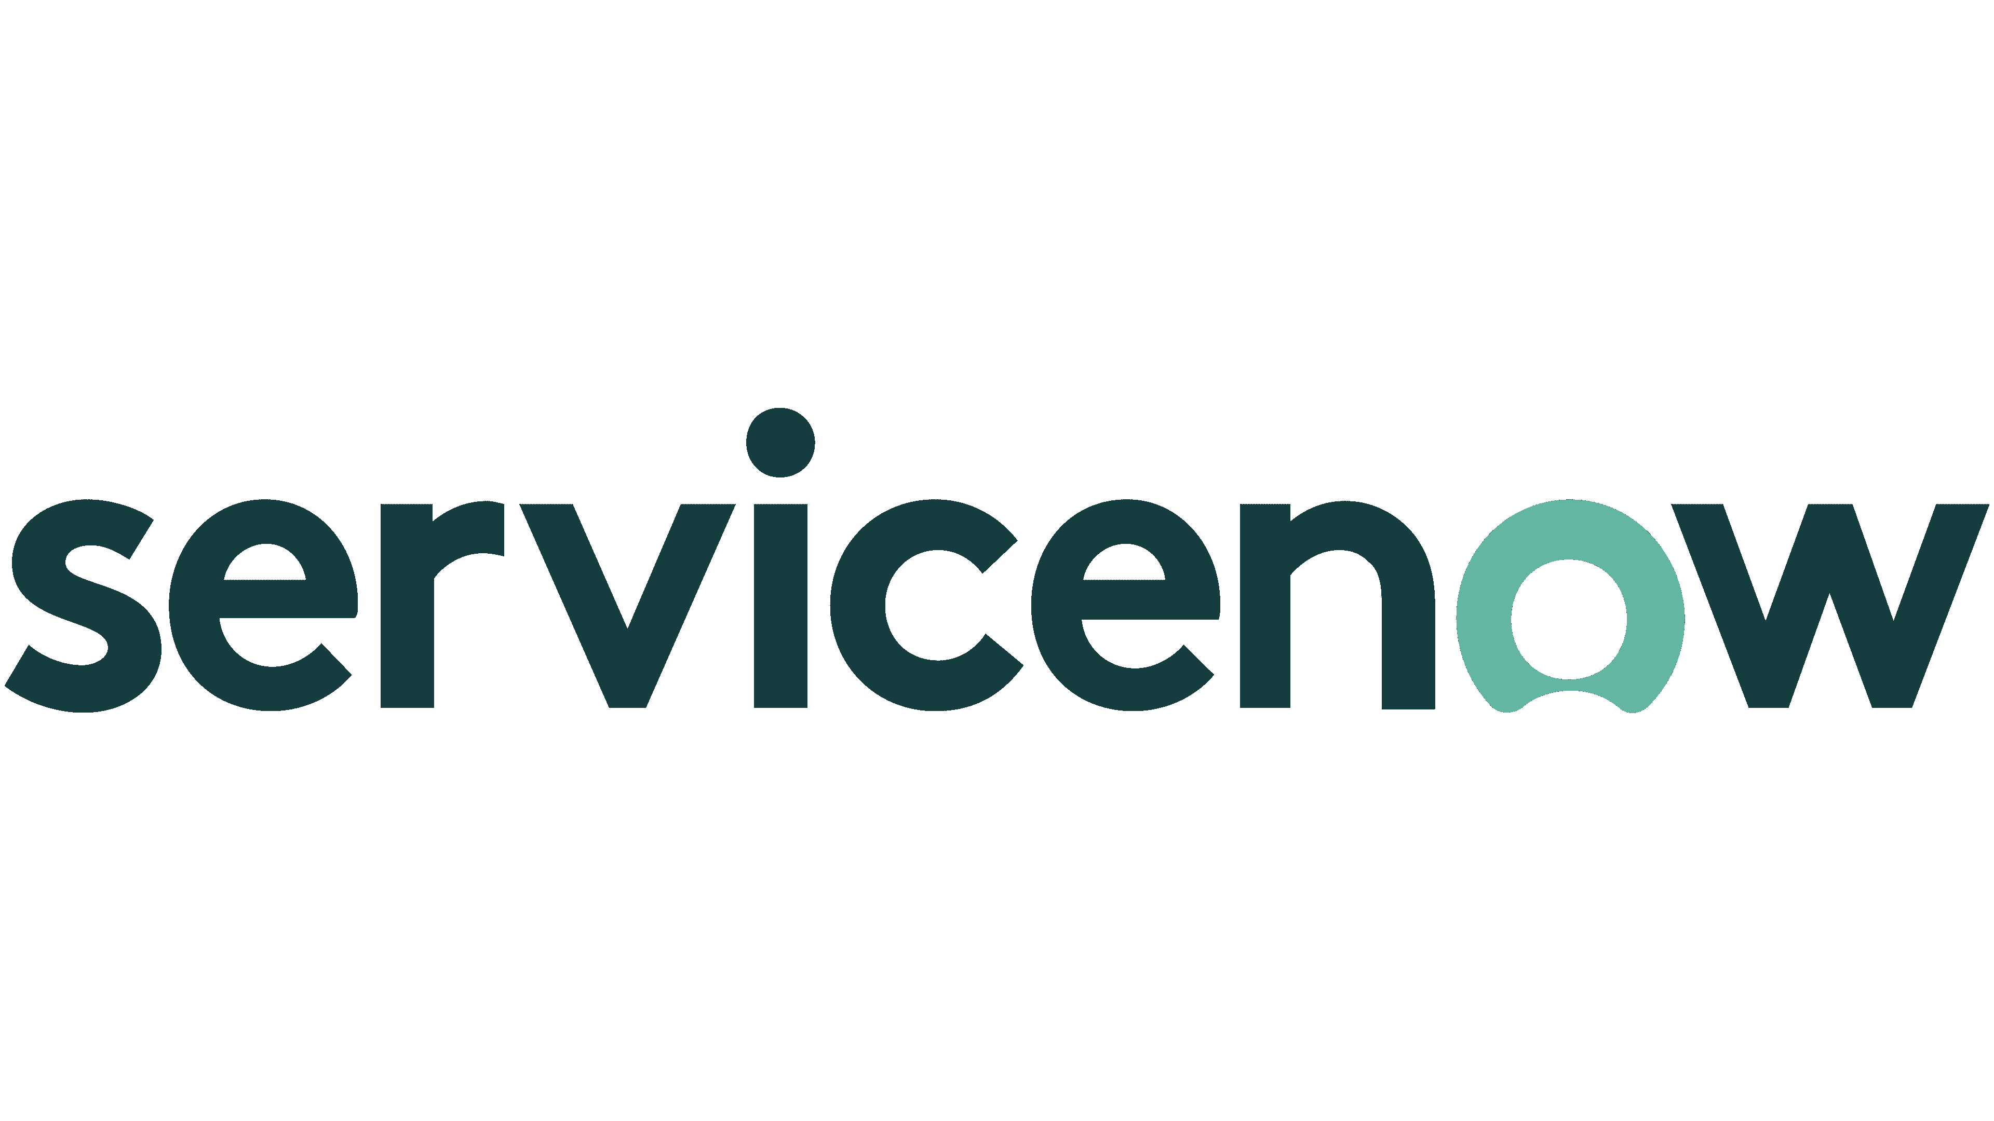



Web Development – Key technologies
In Time Tec – Company Confidential

Slide 106
HP Sales Central
Team Size: 15 | Duration: 4+ Years | Active Maintenance
Project Background:
HPSC is HP Inc's highest user traffic web portal; even higher than hpshopping.com. HP was looking for a development partner to upgrade the web application to address evolving business needs HPSC contain the latest HP product information, sales and marketing training material, and customizable presentations for HP internal sales/marketing, HP resellers, HP partners, and other approved users
B2B application ; Access: HP internal and external
Target user group: WW sales and marketing
Solution In Time Tec Offered:
In Time Tec upgraded the HPSC web application portal both technology stack and its sales/marketing content
In Time Tec redesigned the entire web application to match the latest UI/UX trends and provide a seamless experience for the end users.
Outcome:
In Time Tec helped in achieving speed, performance, efficiency and usability through the newly redesigned HPSC web application.
Provided personalized user experience and content for over 65 countries and 30+ languages.
In Time Tec – Company Confidential

Slide 107
PRINTING - CASE STUDY #2 (HP – 2/10)
Project name: HP Services Estimator | Team Size: 15| Duration: 5+ Years | Active
HP Internal - Global
Project Background: (SPOC-Tarun)
Service Estimator is a web application which provides a one-stop solution to HP Sales team to add hardware and lifecycle services as per their requirements and to get rough pricing estimation which helps them in working more efficiently and improves the overall employee experience.
Solution In Time Tec Offered: MPS (Services) Estimator
In Time Tec utilised existing application which was developed for another business unit within HP, understood the implementation and modified it for Services Estimator. Application was also integrated with new systems to bring in accurate data and minimise human intervention. Project included implementation of ETL(Extract, Transform and Load) process, DevOps and AWS Lambda functions.
Target User Group: HP Sales Team Team Structure: 1 Sr Software Engineer(Development), 3 Software Engineer(Development), 1 Sr Software Engineer(QA)

Slide 108
PRINTING - CASE STUDY #2 (HP – 2/10)
Project name: HP Services Estimator | Team Size: 15| Duration: 5+ Years | Active
Outcome:
Since Services Estimator integrated with multiple other systems, it was easy to bring in new services to the platform. This allowed sales team to move away from excel to a system helping HP to achieve its goal of digital transformation.
Services Estimator utilised new CI/CD solution which helped HP in maintaining their applications and infrastructure.

Slide 109
PRINTING - CASE STUDY #3 (HP – 3/10)
Project name: HP S&M Portal | Team Size: 19+| Duration: 2+ Years | Active
HP Internal - Global
Project Background: (SPOC-Raunak)
Developing a portal that provides a one stop solution for the application users for managing inventory to capitalize the business gains.
Solution In Time Tec Offered: Inventory Management
S:ARA Application Overview: Supplies and advanced replenishment (S: ARA) is a project by HP to manage its inventory for the following products to have the maximum business gains.
Ink, Toner, Uk and Tx
The project deals with the scope of managing inventory of the above products to capitalize the business gains by managing the quantity of the products, which are to be delivered to its market.
Currently used by Pilot Distributors - 10
BP and DBMs - ~10-20

Slide 110
PRINTING - CASE STUDY #3 (HP – 3/10)
Project name: HP S&M Portal | Team Size: 19+| Duration: 2+ Years | Active
Outcome:
Developed application helps:
Business Planner to channelize the streams of products that are to be delivered to a specific distributor in order to have stability and productivity in the distribution of the products.
The Distributor distributes the products to the consumers and can observe the relevant data for the product to manage his business requirements. The exposure to the data is limited to the distributor as compared to Business Planners and the DBM’s.

Slide 111
HP Sustainability Calculator -GAIA
Team Size: 9| Duration: # 1 year| Active
Project Background:
To enable customer to understand the sustainability metrics such as energy consumption, eco-labels, and recycle content of the product and be able to compare this with other HP products, competitor products and legacy products – for use in tenders, customer presentation and business cases for a product/fleet.
B2B application ; Access: HP internal access
Target user group: Great Britain and France for now
Team structure: 7 Software engineers (Development); 1 Software engineer (QA)
Solution In Time Tec Offered:
Web application where HP employees can compare different products or fleets based on the sustainability data provided by the tool. This will empower customers to recognize sustainability savings and benefits of HP Products at RFP/RFI stage.
Outcome:
This solution can act as a standalone application or be integrated in other portals in future. We are providing consolidated sustainability metrics for product/fleet comparison, by consuming data from multiple data sources.
In Time Tec – Company Confidential

Slide 112
PRINTING - CASE STUDY #6 (HP – 6/10)
Project name: HP Portico fleet Fleet Mapping & Design| Team Size: 8| Duration: 5+ Years | Active |
Project Background: (SPOC-Mahesh)
Portico is a team within HP that takes care of MPS solutions. Client was looking for a solution to track the printing assets on a particular floor or building.
Solution In Time Tec Offered: Web Application Development
[Printing/MPS] Portico is a different flavour of Cartos (home grown product by In Time Tec) used by HP with added features dedicated to HP. This is an internal application used at different HP sites for building up the print infrastructure.
Portico is an application or tool for MPS - 'Managed Printing Services'.
It is used by fleet designers to manage and provide service to the valuable customer(s).
It allows these MPS providers to optimize the floor plan of the companies and help organizations to reduce costs on print services, maintenance, and better utilization of the resources available.
In Time Tec is also responsible for L3 support which is part of product O&M (Operations & Maintenance) for Portico.
Access: Internal
Target User Group: HP sites in US
Team Structure: 1.5 Software Engineer (Development) ; 0.5 Software Engineer (QA)

Slide 113
PRINTING - CASE STUDY #6 (HP – 6/10)
Project name: Portico | Team Size: 8| Duration: 5+ Years | Active
Outcome:
It allows the visualization and optimization of MPS fleets through every phase of the MPS: pre-sales, fleet design, fleet deployment, service technicians, post-sales, and obsolesce life cycle.

Slide 114
HP Smartfleet
Team Size: 8| Duration: 6+ Years | Active
Project Background:
The Smart Fleet Early Warning Detection System monitors printer telemetric error data and intervention data on a routine basis. HP users, engineers and account managers, would like to receive alerts when printer errors or intervention data is increasing
Solution In Time Tec Offered:
A web portal for HP user to subscribe to Smart Fleet alerts and to create their own custom alerts. It provides the following:
Creation of Custom Alerts ; View Created Custom Alert
Edit/Modification of Custom Alerts ; Rename of Custom Alerts
Deletion of Custom Alerts ; Cloning custom Alerts
Outcome:
Web portal for HP user to subscribe to Smart Fleet alerts and to create their own custom alerts.
In Time Tec – Company Confidential

Slide 115
PRINTING - CASE STUDY #8 (HP – 8/10)
Project name: HP ITSM DAAS /MPS | Team Size: 16| Duration: 3+ Years | Active
Project Background: (SPOC-Poola)
HP Inc leases printers, laptops, servers, cloud instances etc on chargeable basis based on the usage. ServiceNow is used for service management, change management, problem and incident management, asset management, task management and knowledge management.
(DaaS = Device as a Service ; MPS = Managed Print Service)
Solution In Time Tec Offered: Software Qualification & Automation
We offered the support on Qualification of the new feature development and maintenance of the same. Automating the tests to decrease the manual efforts in regular huge regressions.
MPS project was completed in Dec-2022 which had team size of 12 engineers. Currently we are supporting DAAS project.
Access: External
Target User Group: HP assets users
Team Structure: 14 Software Engineer (QA/SDET) ; 2 Support Engineer ( Platform Admin and support )

Slide 116
PRINTING - CASE STUDY #8 (HP – 8/10)
Project name: HP ITSM DAAS /MPS | Team Size: 16| Duration: 3+ Years | Active
Outcome: Delivered the high-quality application and the automating the regression suite and constant support on the issues occurred.

Slide 117
HP Daas Portal
Team Size: 8 | Duration: 6+ years | Active
Project Background:
To give HP Customers and Partners a one-stop portal for everything PS (Personal Systems) services related. Execution of the transition to the LAER model – Land, Adopt, Expand, Renew.
Solution In Time Tec Offered:
PS Services Portal tool is a web-based application for HP enterprise direct customers. HP PS Services Portal is your one place for all things HP Personal Systems Services. HP Personal System Services partners with customers to increase user productivity, operational efficiency, and cost predictability.
Outcome:
HP PS portal (i.e., HP Daas Portal) helps the organization manage their Customers, Contracts, Orders, Assets, and Services effectively.
In Time Tec – Company Confidential

Slide 118
HP ITSM Development
Team Size: 2 | Duration: 3 months + | Active
Project Background:
ITSM is an infrastructure management system for HP assets (devices). It was an ongoing project for more than 5 years and multiple vendors were supporting the project. Client considered In Time Tec to support with development project as we were already providing Qualification, Automation and L1 Support for ITSM for more than 2 years.
Solution In Time Tec Offered: Software Development
Capability Managers are providing different requirements they receive from their vendors as per business specific use cases. In Time Tec receives requirement and prepares implementation plan to develop and deliver as per documented requirements.
Currently, a lean team is working on the project. and it is expected that team will be upsized to 10+ ServiceNow Developers by over next 9 months.
Outcome:
In Time Tec team has been delivering with quality and consistency.
In Time Tec – Company Confidential

Slide 119
PRINTING - CASE STUDY #9 (HP – 9/10)
Project name: HP PPU | Team Size: 4| Duration: 2+ Years | Active
B2B - Global
Project Background: (SPOC-Neetima)
HP Large format print sales and marketing team was using excel to calculate profit margins and price outcomes. Entire process was manual and error prone. This was automated through the (web application) calculation tool we created. Including downloadable PDFs of the work done.
Solution In Time Tec Offered: Web Application Development
[Printing/MPS] Large Format Print Portfolio Configure & Price is a pricing simulator that recommends payment quantities for pay-per-use contracts. It estimates values for PageWide XL, DesignJet and Latex printers.
Access: Internal / HP Partners (Resellers)
Target User Group: Global
Team Structure – 1 Software Engineer

Slide 120
PRINTING - CASE STUDY #9 (HP – 9/10)
Project name: HP PPU | Team Size: 4| Duration: 2+ Years | Active
Outcome:
Easy to use tool for HP Partners all over the world. They can login, select printers, configure required services and check final prices with modified margins. Aid in sales and marketing.

Slide 121
PRINTING - CASE STUDY #9 (HP – 9/10)
Project name: HP Configurator | Team Size: 4| Duration: 6+ Years | Active
B2B - Global
Project Background: (SPOC-Neetima)
HP Configurator was started as a proposal to meet HP MPS user needs to explore various configurations of printers, understand detailed specifications and customize a configuration based on customer's specific needs.
Solution In Time Tec Offered: Web Application Development
[Printing/MPS] Capitalize on HP's Managed portfolio
HP Print Product Configurator:
Meet Clent's needs by creating a valid configuration for any A3 or A4 device across HP’s managed print portfolio.
HP Partner Price Book Tool:
Build price book for HP’s complete managed print portfolio with easy access to all component level pricing, operating cost per page (OCPP) metrics, product information, and margin calculations
Access: Internal / HP Partners (Resellers)
Target User Group: Global
Team Structure – 1 Software Engineer ; 0.5 Software Engineer (QA)

Slide 122
PRINTING - CASE STUDY #9 (HP – 9/10)
Project name: HP Configurator | Team Size: 4| Duration: 6+ Years | Active
Outcome:
Flexibility for worldwide HP direct users and partners to load pre-configured packages with A3/A4 printers. Modify configurations as per need. Calculate estimated operating cost per page. Load country wise pricebook which is a catalog of HP's managed print portfolio with details of each product and prices.
Overall enhances the process of sales and marketing.

Slide 123
PRINTING - CASE STUDY #1 (Pharos – 1/1)
Project name: Pharos Service | Team Size: 18+| Duration: 4+ Years | Active
Project Background: (SPOC-Kapil)
Client was looking for a technology partner who would help with custom software development for their customers (leading printer manufacturers).
Solution In Time Tec Offered: Web Application Development
[Secure Printing] It is an enterprise solution for a secure printing which includes the pull printing and server based/less printing. It includes the encryption of information and keeps the confidentiality of the printing. It support various vendors of the printers as HP, Ricoh, cannon, KM and lexmark.
Access: External
Target User Group: Global
Team Structure: 13 Software Engineers (Development), 2Software Engineers (QA)

Slide 124
PRINTING - CASE STUDY #1 (PHAROS – 1/1)
Project name: Pharos Service | Team Size: 18+| Duration: 4+ Years | Active
Outcome:
1. Developed complete secure print solution for Toshiba, Lexmark and Canon
2. Developed touchless printing feature for Toshiba, HP, Canon, Xerox, Konica Minolta and Lexmark
3. Scan to feature development for Toshiba, HP, Canon, Xerox, Konica Minolta and Lexmark
4. Smartcard authentication for Ricoh Printers

Slide 125
PRINTING - CASE STUDY #1 (CARTOS – 1/1)
Project name: Cartos | Team Size: 16| Duration: 6+ Years | Active
Project Background: (SPOC-Mahesh)
Cartos is a cloud-based fleet design and asset utilization tool for Managed Print Service (MPS) providers. The name "Cartos" is derived from Cartography, or the study of maps. Cartos allows MPS providers to optimize sites, gain more control on print services and provide more efficient costs, maintenance and resource utilization.
It is a home-grown product used by clients such as Sharp Global, CopyPro, Inc, and Pharos Systems International, Inc.
Solution In Time Tec Offered: Web Application Development
[Printing/MPS] Cartos is home grown SaaS product offered as an asset plotting system for managing printers on the floors. Clients use this application via APIs exposed by the product.
Team Structure:
12 Software Engineers (Development)
2 Software Engineers (QA)
1 DevOps Engineer

Slide 126
PRINTING - CASE STUDY #1 (CARTOS – 1/1)
Project name: Cartos | Team Size: 16| Duration: 6+ Years | Active
Outcome:
Cartos helps organizations to optimize sites, gain more control on print services, and provide more efficient costs, maintenance, and resource utilization.

Slide 127
COMPUTERS - SUMMARY
# | Key Clients | Projects
1 | HP Inc | 3
Experience & Expertise (Key Technologies Used)
React JS, Express JS, AWS Lambda, DynamoDB, MongoDB, Cypress, .NET, ServiceNow

Slide 128
HP ITSM L1
Team Size: 5| Duration: 2.5 years | Active
Project Background:
This is a L1 support project. ITSM team uses ServiceNow for tracking the incidents created by the users during the asset transition. It is an HP Asset Management system that tracks the assets throughout the asset's life cycle. Track the asset information and transition.
5 Software Engineers (Support)
Solution In Time Tec Offered:
ITT provides L1 support to receive user and system-generated incidents. Triage them at the initial phase and provide the solution or move them to the L2 team for further troubleshooting and fixing.
Outcome:
The L1 (Level 1) team is the first point of contact providing the ITSM team to segregate incidents to be moved to L2 or resolved at the Level 1 stage.
In Time Tec – Company Confidential

Slide 129
HP Card Reader
Team Size: 2| Duration: 6+ years | Active - Maintenace
Project Background:
The main purpose of the project is to configure a card reader through our utility after which we can read the data from a card that has been configured with the required data
Solution In Time Tec Offered:
This application is a tool – which is used for deployment of HP Card Readers.
Allowing the user to:
1. View card reader device details, view and set how the card reader interacts with users and how the card data is read and sent.
2. Save settings on the device itself or as a JSON file that can be used as a settings template.
3. Decode the data read from a card, and review or edit how that card data is decoded.
Once deployment is complete it is typically uninstalled as it is not required for interaction with the card readers or for the card readers to function.
Outcome:
Provided an easy way to the end users to configure the reader, also an easy way to upgrade the firmware of a reader that is obtained from clients; locally, remote and fleet configuration
In Time Tec – Company Confidential

Slide 130
HP FHM
Team Size: 4 | Duration: 5+ Years | Active
Project Background:
HP FHM (Fleet Health Management): Is a Visualization and Data Management project that helps extract Printer data from multiple unorganized data sources, cleanse and streamline the data, transform and create visualizations for the business group. Using these visualization, HP make market decisions on the Device Error Data and replacements if needed.
Solution In Time Tec Offered:
In Time Tec developed the solution using Microsoft Power BI platform and Python (Data Science).
In Time Tec – Company Confidential

Slide 131
HP S&M Reporting
Team Size: 7| Duration: 3+ Years | Active
Project Background:
HP (S&M) Sales & Marketing Reporting Team mainly works on creating & maintaining Power BI reports for below HP groups -
1) Partner Online Analytics
2) Supplies replenishment
3) Sale productivity tool. Each of the reports are used by HP and the partners to access the sales trend and adopt the required strategy to increase it
Solution In Time Tec Offered:
In Time Tec developed the solution using Microsoft Power BI platform
In Time Tec – Company Confidential

Slide 132
Data Science & Data Engineering Summary
Line Item | Name of Project | Industry Domain | Status
1 | HP Data OS (Data Engineering) | Printing | Active
2 | HP S&M (Data Engineering) | Printing | Active
3 | HP Smartfleet (Data Science) | Printing | Active
In Time Tec – Company Confidential

Slide 133
Data Engineering – Key technologies
Purpose | Tools
Scripting | Python
To Query the data | SQL, Spark SQL.
Data Storage | AWS Redshift and AWS S3
Data Processing | Databricks, DBT and Spark
Monitoring, Reporting and Alerting | Splunk, Looker and Power BI
Pipeline Orchestration | Airflow and Databricks Scheduler
Code version control and collaboration | GitHub Enterprise
Automated Deployment | Azure Data Pipeline
In Time Tec – Company Confidential

Slide 134
HP Data OS
Team Size: 17| Duration: 3+ years | Active
Project Background:
We started the HP DataOS Data Engineering project 3 years ago with one project called P2-retargeting with a team of 3 Data Engineers.
Now, we have 3 projects with DataOS with 17+ engineers:
HP P2-Retargeting (now CASCADE) - 9 Data Engineers
HP Specialty data - 4 Data Engineers, and
HP Data Products of 4 Data Engineers.
Solution In Time Tec Offered:
The nature of work in all 3 sub-projects is similar. we extract the mass quantity of data around 10 millions of records per day from the client data sources, we process the data, and we write the data to client destination data sources.
Data Processing includes data cleaning, data validation, encryption, decryption, data privacy checks and Data Migration.
All the data pipelines were designed and developed by our team.
Outcome:
All our data pipelines are highly scalable and automated. We do rigorous monitoring of data and pipelines to trace the abnormalities to alert the Data Engineers and the data source teams to take timely actions.
In Time Tec – Company Confidential

Slide 135
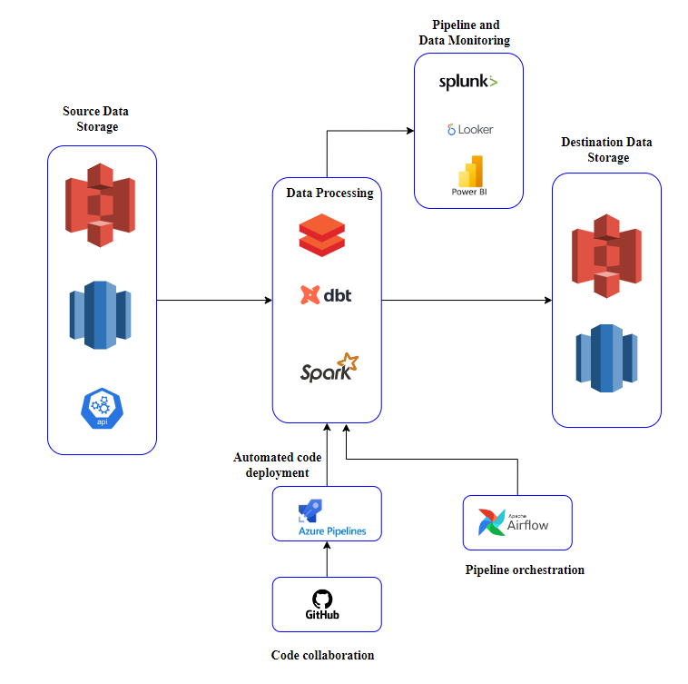
HP DATAOS ENGINEERING: Workflow

Slide 136
HP Sales & Marketing (Data Eng.)
Team Size: 15+| Duration: 3+ years | Active
Project Background:
HP Sales and Marketing project engagement started with couple of engineers; now is more than fifteen engineers; supporting across below threads encompassing varied needs.
•Inventory ; Internal Data Engineering Tier 1 ; Market Place ; Global Unified DS ; ML Alarm ; Neptune ; SARA
Solution In Time Tec Offered:
Data ingestion from multiple sources and Data wrangling
Creation of the pipelines & flows.
Handling partitioning challenges arising on account of Scale of the Data.
Scheduling execution of operation for given scenarios or at given scheduled time.
Creation of dashboards / Teams notification alerts tracking Datasets / Scenarios.
Development of Data Dictionaries, to augment missing documentation.
Streamlining the PyTrends data fetcher using proxies / different retry mechanisms.
Monitoring pipelines to make sure the source datasets are up-to-date and need-based triaging.
Conversion of given SQL queries into PySpark pipeline.
In Time Tec – Company Confidential

Slide 137
HP S&M: Summary
HP S&M project engagement started with couple of engineers; the corresponding strength now is 15+ engineers; supporting across below threads encompassing varied needs.
Inventory.
Internal Data Engineering Tier 1.
Market Place.
Global Unified DS
ML Alarm
Neptune
SARA…

Slide 138
HP DATAOS ENGINEERING: Summary
Data ingestion from multiple sources, like
Amazon Vendor Central, Best Buy, Criteo, Office Depot, Staples, TERA / ORCA / Postgre / ATHENA / APOLLO etc.
Share point; From various file types like say, Json, Xml, excel
By virtue of Web Crawlers and Email Crawlers
Data wrangling of the above data.
Creation of the pipelines & flows.
Handling partitioning challenges arising on account of Scale of the Data.
Scheduling execution of operations; for given Scenarios or at given scheduled time.

Slide 139
HP S&M: Tools & Technology
Purpose | Tools
Frameworks / IDE | DataBricks, Dataiku, Jupyter Notebook / Spyder
Languages | Python / 'R' Language, Spark / PySpark, SQL, Redshift, MsSql, Sparksql
Database | Postgres
Libraries | Scikit-learn NLTK / TextBlob / SpaCy / RegEx Pandas / NumPy / SciPy Seaborn Beautiful Soup
Crawlers | Selenium (Web Crawler) win32com.client (E-Mail Crawler) with Django / Flask framework

Slide 140
HP S&M: Tools & Technology
Purpose | Tools
Tools / Services | Azure Services for MLOps (MLTool, ML Studio, ML Service, Functions, Blob storage, DevOps) Azure Codeway AWS services (S3, Secrets Manager) Airflow Elasticsearch and Kibana SSMS Splunk / OpenSearch / looker (Monitoring and Alerting Tool) / PowerBI CROSSFILTER, D3, TopoJSON Salesforce Marketing Cloud

Slide 141
HP Smartfleet (Data Science)
Team Size: 15+ | Duration: 5+ years | Active
Project Background:
Printer product numbers/event codes reported from the field were mislabelled in the HP database causing data anomalies. This would result in incorrect data analysis drawing ineffective conclusions. Data collected from printers are skewed, resulting in rogue data. If left unattended, the dataset would later grow, resulting in an ineffective analysis.
Solution In Time Tec Offered:
Automated analysis would pinpoint clusters of devices with unusual product number-event code association, which can then be passed on to field engineers for validation. Anomalies are rare events but can be a major problem when they occur. Given the pattern of data, the engine should determine if there is an anomaly. Anomalous patterns can be flagged for immediate investigation. It can benefit the customer by proactively resolving the issues than doing it reactively.
Outcome:
Predictable printer data forecasting pattern.
Properly label device product numbers/event codes reported from the field in the database.
Automated analysis would pinpoint clusters of devices with unusual product number-event code association, which can then be passed onto field engineers for validation to cross verify and take action.
In Time Tec – Company Confidential

Slide 142
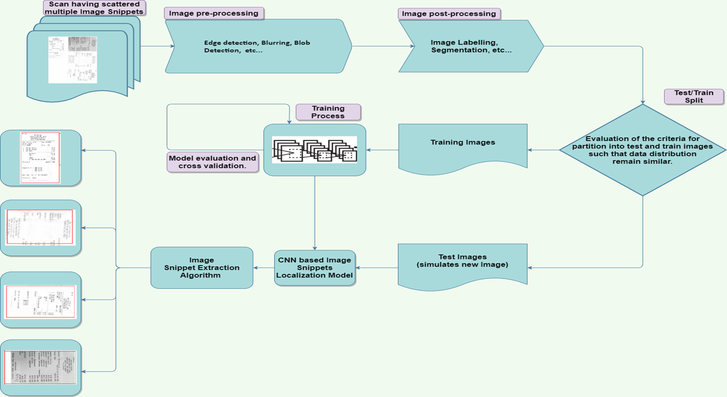
Receipt Localization & Cropping: Summary
Problem Statement
Extraction of each receipt from a single A4/A3 page having multiple receipts scanned therein.
Solution
Convolution Neural Network (CNN) for Computer Vision-based localization, and extraction of each receipt from scans of multiple (business-expense) receipts on to A4/A3 page.

Slide 143
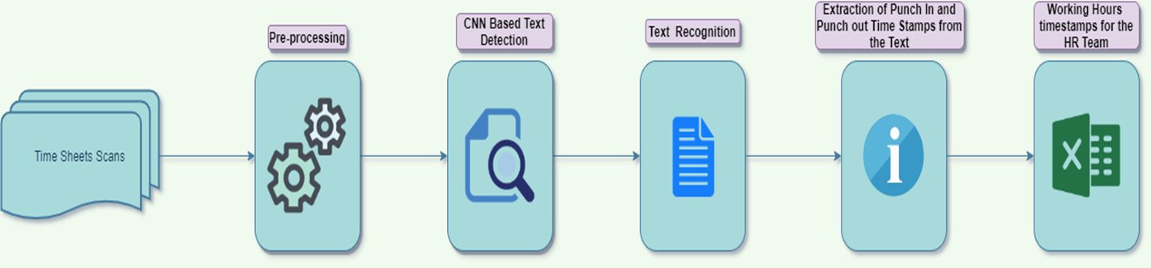
Timesheet Inferences
Problem statement
The thought behind this application is-to extracts the In Time and Out Time from the scanned picture.
Solution Approach
Input is scanned-images of the attendance sheet. A CNN-based algorithm is used to detect and extract the content of the different sections of the scanned images. Out interest is only to-extract the IN Time and Out Time entered. From the In Time and Out Time, the employee's complete working hour is being determined for the HR group to keep track of the working hour.

Slide 144
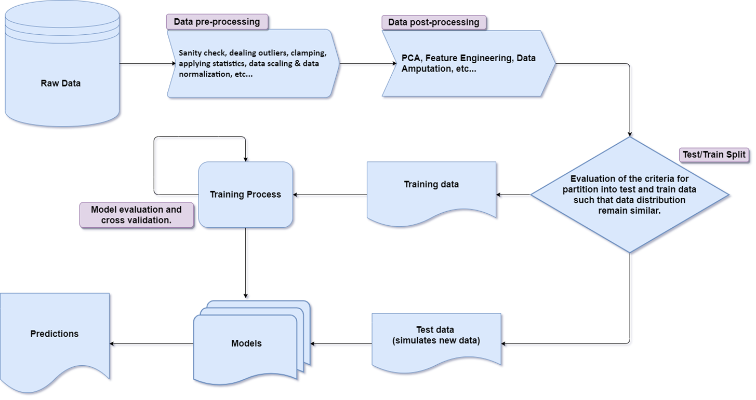
Prediction Models: Summary
Problem Statement
Missing printer data, noisy data, and mix-up of prices expressed in different currencies, dimensions / weight / resolution / print speed / power rating in different units, and at times, sparse data.

Slide 145
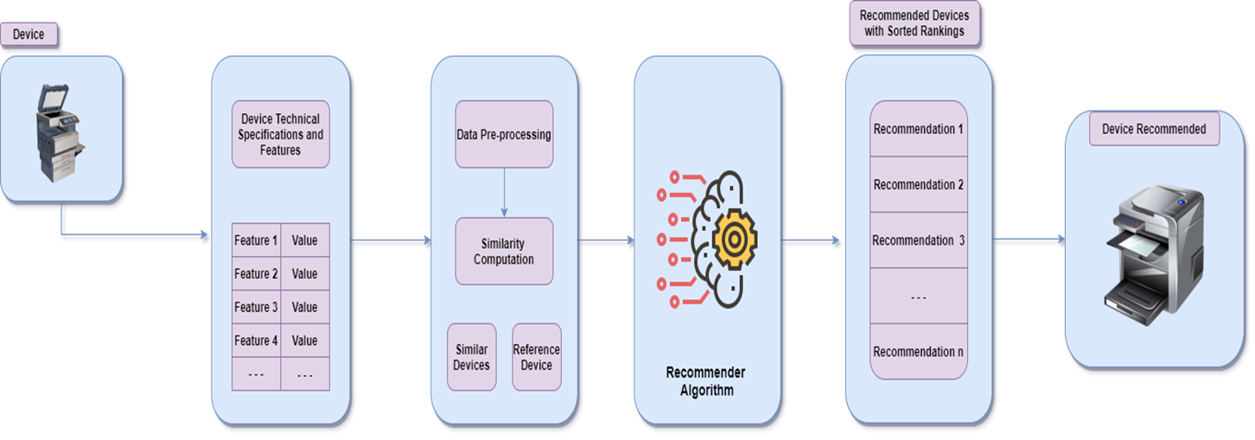
Asset Adviser: Summary
Problem Statement
Recommendation of Device, which is functionally and technically closest possible to the Reference Device; while satisfying given constraints.
Solution
Recommender, which would suggest an alternative device, based on Multiple-criteria e.g., Price, Make, Age, and Pages printed per minute, Resolution, Device Type, Device Technology, and A4/A3 Support.

Slide 146
Embedded Systems & IoT
Line Item | Name of Project | Industry Domain | Status
1 | HP Device Common Firmware | Printing | Active
2 | HP Print At Your Service | Printing | Delivered
In Time Tec – Company Confidential

Slide 147





Embedded Systems & IoT – Key technologies
In Time Tec – Company Confidential

Slide 148
HP Device Common Firmware
Team Size: 46+| Duration: 3+ years | Active
Project Background:
The device common firmware platform is a global HP project that applies one firmware code across all the HP devices from small business to large format market. Our team assists HP in delivering the foundations and capabilities in several key modules.
Solution In Time Tec Offered:
Our areas of expertise include the development of firmware (FM) and software development kits (SDK) for HP imaging and printing devices.
We integrate a web server within the device so that it may be configured via the network using a standard web browser.
We provide a core view framework that offers infrastructure to support all user interfaces across all products.
We create walk up features and build components to assist client in comprehending and troubleshooting HP device system conditions.
We help our client in all phases of software development, be it design, development, E2E testing, or support.
Outcome:
In Time Tec takes full ownership of the module assigned – and recommends new design, features on an ongoing basis. Key highlights -
1. Highest quality release for Beta (every quarter) for both E2 Firmware & SDK with a 97% pass rate
2. Own the overall work so that HP employees can concentrate on crucial tasks
- In Time Tec Tech Leads / Architects drive the work while HP validates and approves the approaches
3. In Time Tec has added buffer resources with various skills across many streams
- Assist in maintaining the velocity
- Unpaid resources aid in fixing bugs while not impacting HP budget
In Time Tec – Company Confidential

Slide 149
HP Print at your service
Team Size: 5 | Duration: 2+ years | Delivered
Project Background:
The project was a combination of two applications that involved web as well as embedded application development.
Solution In Time Tec Offered:
Web Application - To setup, configure, monitor and upgrade Linux based thin clients that were running at various customer locations.
Embedded Application - Custom application built and deployed on Linux based thin clients. The main functionality of the application is tracking the usage on the printers in the same network.
Tech stack used - Angular, C#, Linux scripting, Docker
In Time Tec – Company Confidential

Slide 150
HEALTHCARE - CASE STUDY # (RISE Services)
Project name: CPI | Team Size: 1.5| Duration: 10+ years | Active - Maintenance
Project Background: (SPOC - Raunak)
A platform that provides the management(finding a job, building relationships, accessing the community, or learning to become more independent and dedicated to helping the individuals to serve to be successful in achieving their goals.) to support children & adults with the development disabilities.
Solution In Time Tec Offered: (Brief Phrase)
Community Partnerships of Idaho (CPI) is a multi-service agency, a portal that helps in providing support for children and adults with development disabilities and mental illness.
In the Project CPI, we are tracking the data of the client and helping staff to work more efficiently on the client. The Project divides into the Modules as per requirement and the application is mainly divided into three Parts
Development Services – Adult (ADS)
Residential Habilitation (ResHab)
Admin

Slide 151
HEALTHCARE - CASE STUDY # (RISE SERVICES)
Project name: CPI | Team Size: 1.5| Duration: 10+ years | Active
Outcome:
A web portal that helps in tracking the data of the client and helping staff to work more efficiently on the client.
.

Slide 152
HEALTHCARE - CASE STUDY # (Healthwise)
Project name: Healthwise | Team Size: 6| Duration: 3 months | Active
Project Background: (SPOC - Prasun)
Customer came for technology upgrade project.
Solution In Time Tec Offered: (Brief Phrase)
Migration Project from .Net 4.7 to .Net 6.0 Team is testing and migrating the existing pre built codebase. There are 32 services involved in the project with different integration and libraries to be updated.

Slide 153
HEALTHCARE - CASE STUDY # (Healthwise)
Project name: Healthwise | Team Size: 6| Duration: 3 months | Active
Outcome:
Project had successful outcome and improved overall performance of the web application.
.

Slide 154
CONSTRUCTION - SUMMARY
# | Key Clients | Projects
1 | Redbuilt | 1
2 | Sekady Capital | 1
Experience & Expertise (Key Technologies Used)
Angular, .NET, NetSuite, Microsoft Dynamics, Vue.js, Node.js, MongoDB and SQL Server

Slide 155
construction - CASE STUDY # (redbuilt)
Project name: RedBuilt | Team Size: 5| Duration: 3 years | Active
B2B - US
Project Background: (SPOC - Neetima)
RedBuilt is a leader in the design, manufacture and support of proprietary engineered structural wood products for commercial applications. Headquartered in Boise, Idaho, RedBuilt operates four manufacturing plants and 13 design and sales offices throughout the United States.
WebApp: Currently, RedBuilt uses several Access database applications in order to keep their records. These Access applications connects to Microsoft SQL Server through Access linked tables. This causes a delayed response. RedBuilt needs to create a new system stable which should be scalable with improved performance.
Dynamics: Dynamics 365 Sales helps their Sales reps in managing their opportunities, contacts, Companies effectively.
Solution In Time Tec offered: (Workflow Application)
Earlier RedBuilt employees were using a desktop application which has now been converted to a scalable web application with desired features and performance.
Access: Internal
Target User Group: US
Team Structure – 4 Software Engineers, 1 QA

Slide 156
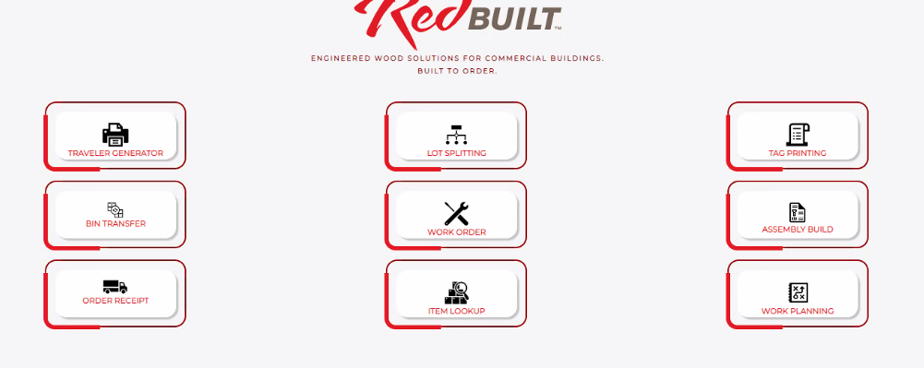
CONSTRUCTION - CASE STUDY # (Redbuilt)
Project name: RedBuilt | Team Size: 5| Duration: 3 years | Active
Outcome:
A web application where RedBuilt internal workers can do inventory management, stock check, order follow ups, work planning etc.

Slide 157
construction - CASE STUDY # (SEKADY CAPITAL)
Project name: Sekady | Team Size: 18| Duration: 2+ years | Active
Project Background: (SPOC - Kuldeep)
Sekady is optimizing construction through technology by helping Builders keep their clients in the loop, manage their builds, and pay Subcontractors. Schedule tasks, send bid requests, and manage your bids - all from our powerful platform. Sekady is providing payment solutions across multiple industries, processing over 6,000 invoices per month and disbursing over $30 Billion in payments historically.
Solution In Time Tec Offered: (Financial Workflow Application)
In Time Tec has helped Sekady to achieve the goal of managing the builds, paying the Appraisers, Subcontractors, scheduling tasks, sending bid requests, and managing those bids by developing many features (like: Bid Manager, Task Manager, Inspection Management, Partial Payment on Invoices, Draw Requests, etc.). And, helped them to redesign the complete UI to improve user experience.
Access: External
Target User Group: US
Team Structure: 12 Software Engineers (Development), 4 Software Engineer (QA, 2 UI/UX

Slide 158
CONSTRUCTION - CASE STUDY # (SEKADY CAPITAL)
Project name: Sekady | Team Size: 18| Duration: 2 years | Active
Outcome: Improved User experience and now Sekady is providing some key features to optimize the construction process by streamlining it to help with the faster payments.
.

Slide 159
DATA ENGINEERING & DATA SCIENCE @ InTimeTec
“Collecting Data is one thing. Knowing what to do with it is another. Both are integral for the future growth of your business” – In Time Tec
Here at In Time Tec, we seek to create abundance with data by having a solid data engineering foundation, followed by a deep understanding of business needs and logic, and then using both to deliver results that are otherwise out of reach including:
Intuitive data visualizations for easy consumption of data
Custom built alerts to give early warning for potential rising issues
Machine learning models that can predict future trends/events, identify patterns of interest, and/or classify data according to predefined categories.F

Slide 160
DATA ENGINEERING & DATA SCIENCE @ InTimeTec
Data engineering is the foundation for all data science work.
Modern data sets are massive, and nobody wants to parse through a billion records.
We automate the process of reviewing massive data sets, so that business owners can see the important stuff, and skip the fluff.
Delivering the important stuff includes giving intuitive visualizations, targeted alerts, and customized data filters.
We harmonize dissonant data into one cohesive source.
Rigorously test data to ensure accuracy and consistency.
Work with upstream data sources to ensure we have best practices through the entire data stream

